Slide 1
Application Delivery Fundamentals 2.0 B:
Introduction to Postgres

Slide 2
Postgres Goals
History Of Postgre SQL
Major Features
Connecting to Postgre SQL DB using psql
Connecting to Pgadmin tool
Writing Simple Queries In Postgre
Understanding Data types
Understanding Single row Functions in PostgreSQL
Specific features of SQL in PostgreSQL as compared to Oracle Database

Slide 3
Postgres Goals
Installing and Configuring Postgre in Windows OS
Understanding Data types in Postgre
New Data type data types of Postgre
Single row functions of Postgre
Understanding Group Functions and writing Queries (Postgre Specific)

Slide 4
Postgres Goals
Understanding DDL’s in Postgre
Creating Tables/Constraints
Understanding DML’s and MVCC in Postgre
Creating Other Database Objects in Postgre
Views/Materialized View/Indexes/sequences
Btree/Partial Indexes In Postgre
Understanding Query Performance issues in Postgre
Explain Vs Explain Analyze options and interpretation
Table Statistics

Slide 5
Postgres Goals
Moving Data the Copy command
Querying Metadata Information Postgre
Compare Dictionaries Vs Meta data tables of Postgre
Table Partitions In Postgre
Partition Setup

Slide 6
Postgres Goals
Introduction to PL/PGSQL
Control structures Overview
Loops Overview
Creating Anonymous blocks in postgre
Understanding Cursors
Bound Vs Unbound Cursors
Creating Subprograms (Stored Procedures/Functions) in PLPGSQL
Exceptions in Postgres
Database Triggers in Postgre
Writing a Function as Trigger body
Basic Architecture of a Postgres DB from the perspective of a developer

Slide 7
What is Postgre SQL
PostgreSQL is an object-relational database management system (ORDBMS) based on POSTGRES,
Version 4.21, developed at the University of California at Berkeley Computer Science Department.
POSTGRES pioneered many concepts that only became available in some commercial database systems much later.

Slide 8
What is Postgre SQL
PostgreSQL is an open-source descendant of this original Berkeley code.
It supports a large part of the SQL standard and offers many modern features:
complex queries
foreign keys
triggers
pdatable views
transactional integrity
multiversion concurrency control

Slide 9
What is Postgre SQL
PostgreSQL can be extended by the user in many ways, for example by adding new
data types
functions
operators
aggregate functions
index methods
procedural languages

Slide 10
Postgre History
The object-relational database management system now known as PostgreSQL is derived from the POSTGRES package written at the University of California at Berkeley.
With over two decades of development behind it, PostgreSQL is now the most advanced open-source database available anywhere.

Slide 11
Postgre History
The POSTGRES project, led by Professor Michael Stonebraker, was sponsored by the Defense Advanced Research Projects Agency (DARPA), the Army Research Office (ARO), the National Science Foundation (NSF), and ESL, Inc.
The implementation of POSTGRES began in 1986.
In 1994, Andrew Yu and Jolly Chen added an SQL language interpreter to POSTGRES.
Under a new name, Postgres95 was subsequently released to the web to find its own way in the world as an opensource descendant of the original POSTGRES Berkeley code.

Slide 12
Postgre History
By 1996, it became clear that the name “Postgres95” would not stand the test of time.
We chose a new name, PostgreSQL, to reflect the relationship between the original POSTGRES and the more recent versions with SQL capability.
At the same time, we set the version numbering to start at 6.0, putting the numbers back into the sequence originally begun by the Berkeley POSTGRES project.

Slide 13
Installation
Download PostgreSQL Installer for Windows
Install PostgreSQL on Window step by step.
Verify the Installation

Slide 14
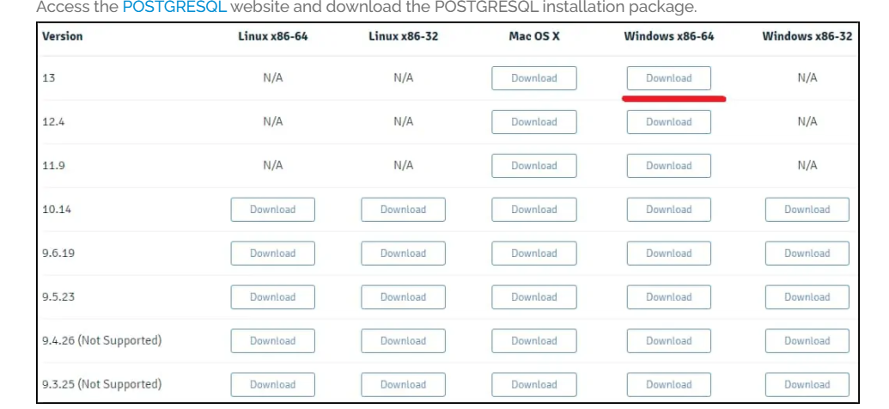
Installation

Slide 15
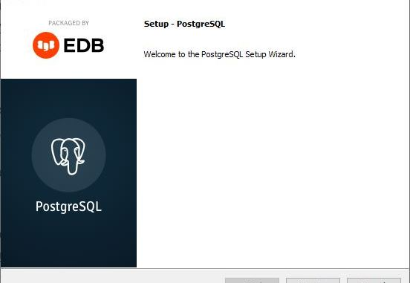
Installation

Slide 16
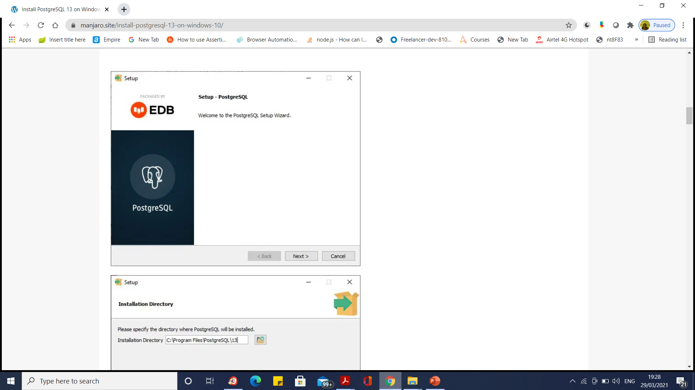
Installation

Slide 17
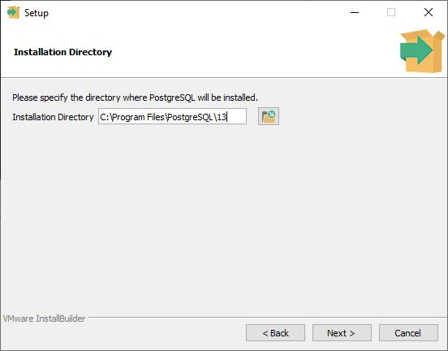
Installation

Slide 18
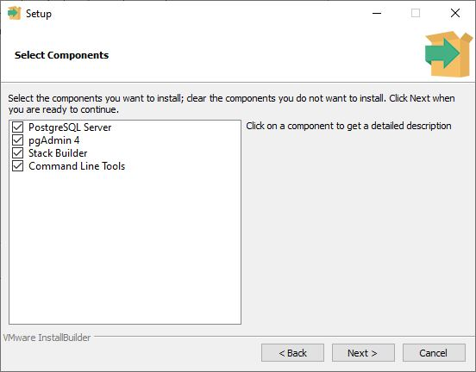
Installation

Slide 19
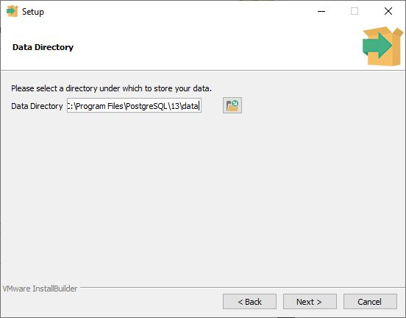
Installation

Slide 20
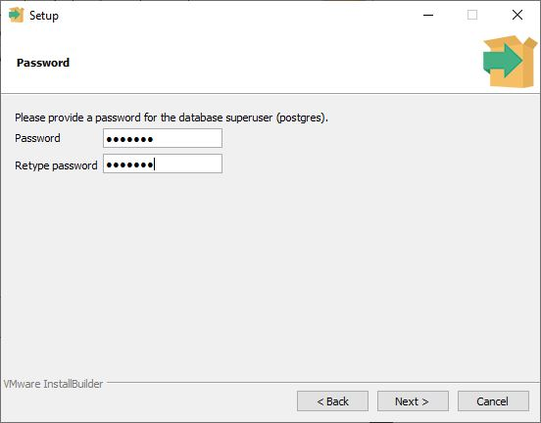
Installation

Slide 21
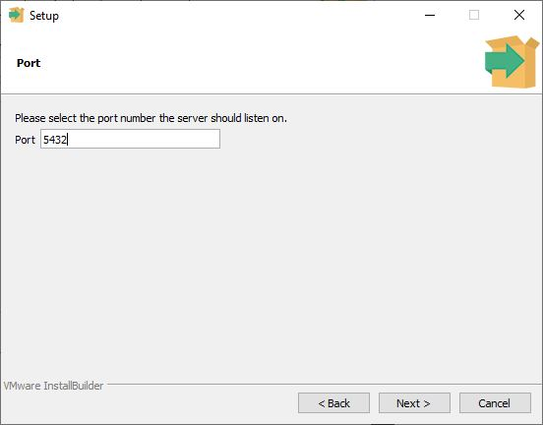
Installation

Slide 22
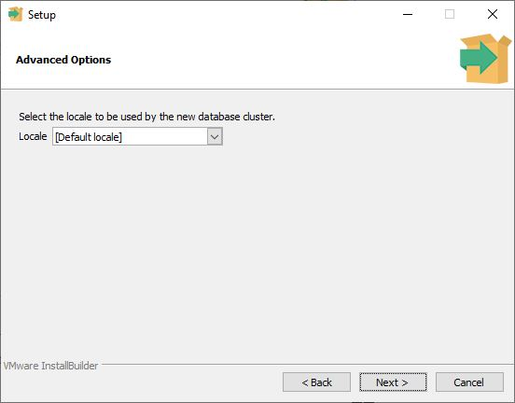
Installation

Slide 23
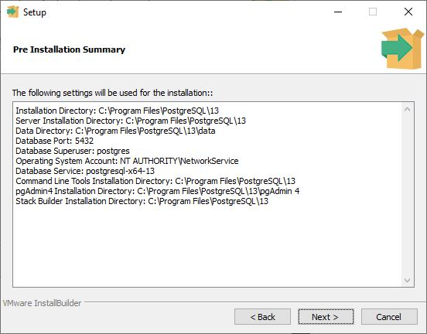
Installation

Slide 24
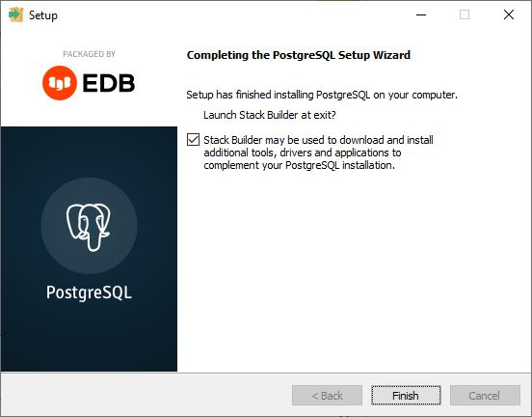
Installation

Slide 25
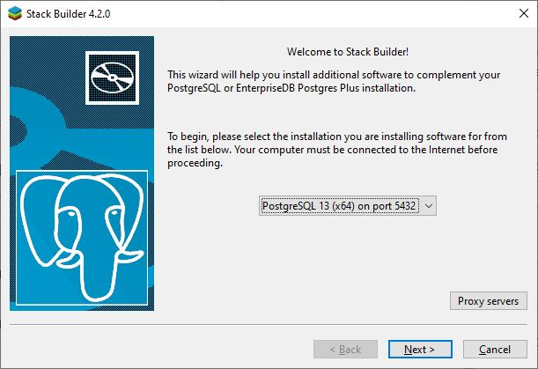
Install PostGIS 3.0 on PostgreSQL 13

Slide 26
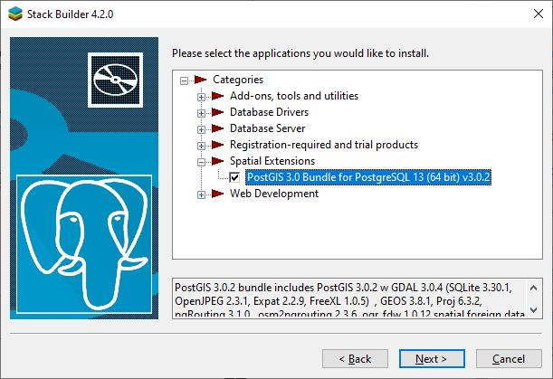
Install PostGIS 3.0 on PostgreSQL 13

Slide 27
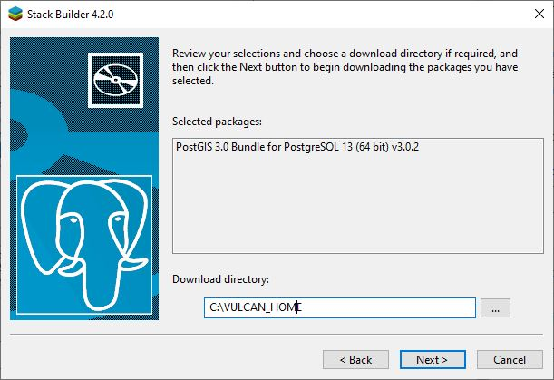
Install PostGIS 3.0 on PostgreSQL 13

Slide 28
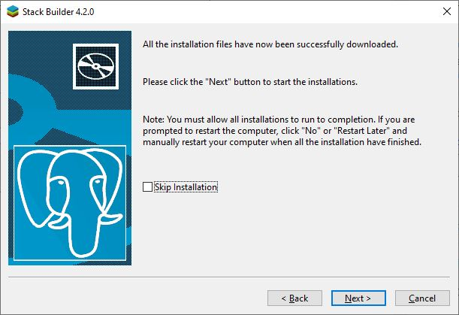
Install PostGIS 3.0 on PostgreSQL 13

Slide 29
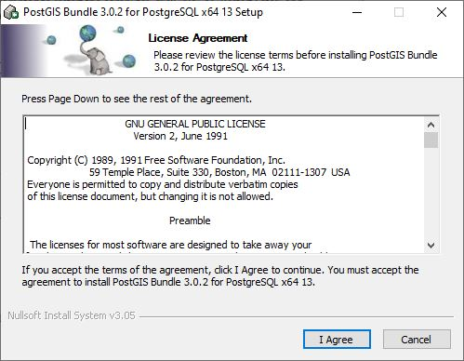
Install PostGIS 3.0 on PostgreSQL 13

Slide 30
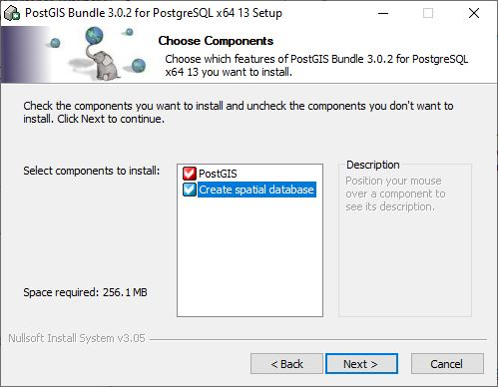
Install PostGIS 3.0 on PostgreSQL 13

Slide 31
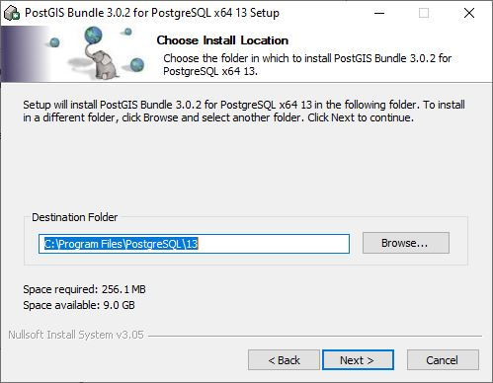
Install PostGIS 3.0 on PostgreSQL 13

Slide 32
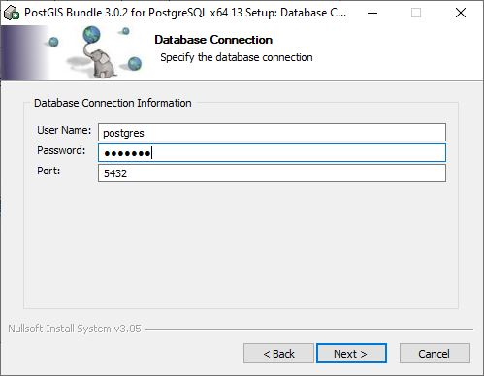
Install PostGIS 3.0 on PostgreSQL 13

Slide 33
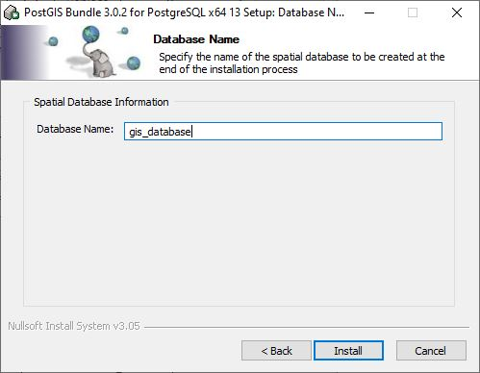
Install PostGIS 3.0 on PostgreSQL 13

Slide 34
Postgre Architecture
PostgreSQL has a Client-server model of architecture. In the simplest term a PostgreSQL service has 2 processes:
Server-side process: This is the “Postgres” application that manages connections, operations, and static & dynamic assets.
Client-side process(Front-end applications): These are the applications that users use to interact with the database.
It generally has a simple UI and is used to communicate between the user and the database generally through APIs.

Slide 35
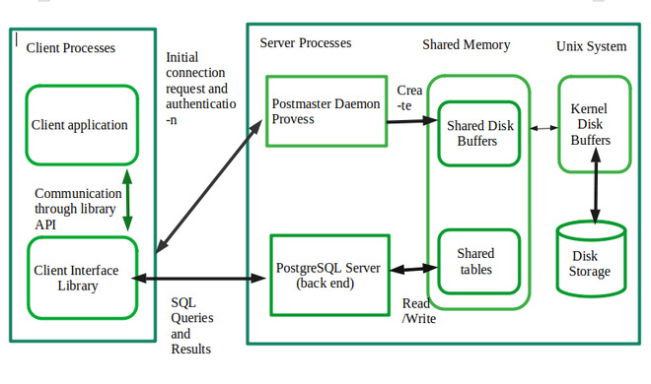
Client side Process

Slide 36
Client side Process
Whenever we issue a query, or the action made by us (client) is called the client process
It is front end.
Front end may be a text application, graphical application or web server page.
Through TCP/IP clients access the server
Many users at a time can access the DB
FORKS – This process makes multiuser access possible. It don’t disturb the postgres process

Slide 37
Client side Process
Client Process refers to the background process that is assigned for every backend user connection.
Usually, the postmaster process will fork a child process that is dedicated to serving a user connection.

Slide 38
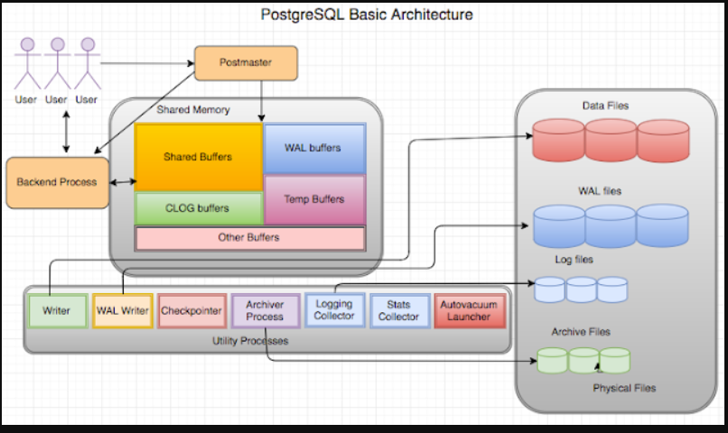
Postgre Architecture

Slide 39
Postgre Architecture
Processes in PostgreSQL can be divided mainly into 4 types:
1. Postmaster (Daemon) Process
2. Background (Utility) Process
3. Backend Process
4. Client Process
Detailed discussion follows

Slide 40
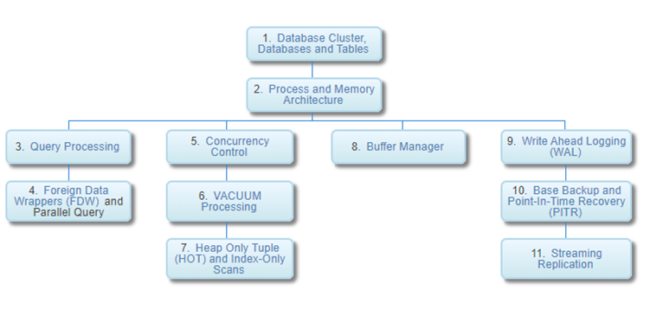
Postgre Architecture

Slide 41
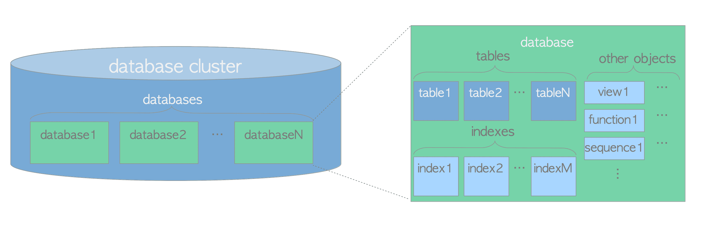
Database Cluster, Databases, and Tables

Slide 42
Database Cluster, Databases, and Tables
A database cluster is a collection of databases managed by a PostgreSQL server.
The term ‘database cluster’ in PostgreSQL does not mean ‘a group of database servers’.
A PostgreSQL server runs on a single host and manages a single database cluster.

Slide 43
Database Cluster, Databases, and Tables
A database is a collection of database objects.
In the relational database theory, a database object is a data structure used either to store or to reference data.
A (heap) table is a typical example of it, and there are many more like an index, a sequence, a view, a function and so on.
In PostgreSQL, databases themselves are also database objects and are logically separated from each other.
All other database objects (e.g., tables, indexes, etc) belong to their respective databases.

Slide 44
Database Cluster, Databases, and Tables
All the database objects in PostgreSQL are internally managed by respective object identifiers (OIDs), which are unsigned 4-byte integers.
The relations between database objects and the respective OIDs are stored in appropriate system catalogs, depending on the type of objects.
For example, OIDs of databases and heap tables are stored in pg_database and pg_class respectively,

Slide 45
Database Cluster, Databases, and Tables
All the database objects in PostgreSQL are internally managed by respective object identifiers (OIDs), which are unsigned 4-byte integers.
The relations between database objects and the respective OIDs are stored in appropriate system catalogs, depending on the type of objects.
For example, OIDs of databases and heap tables are stored in pg_database and pg_class respectively,

Slide 46
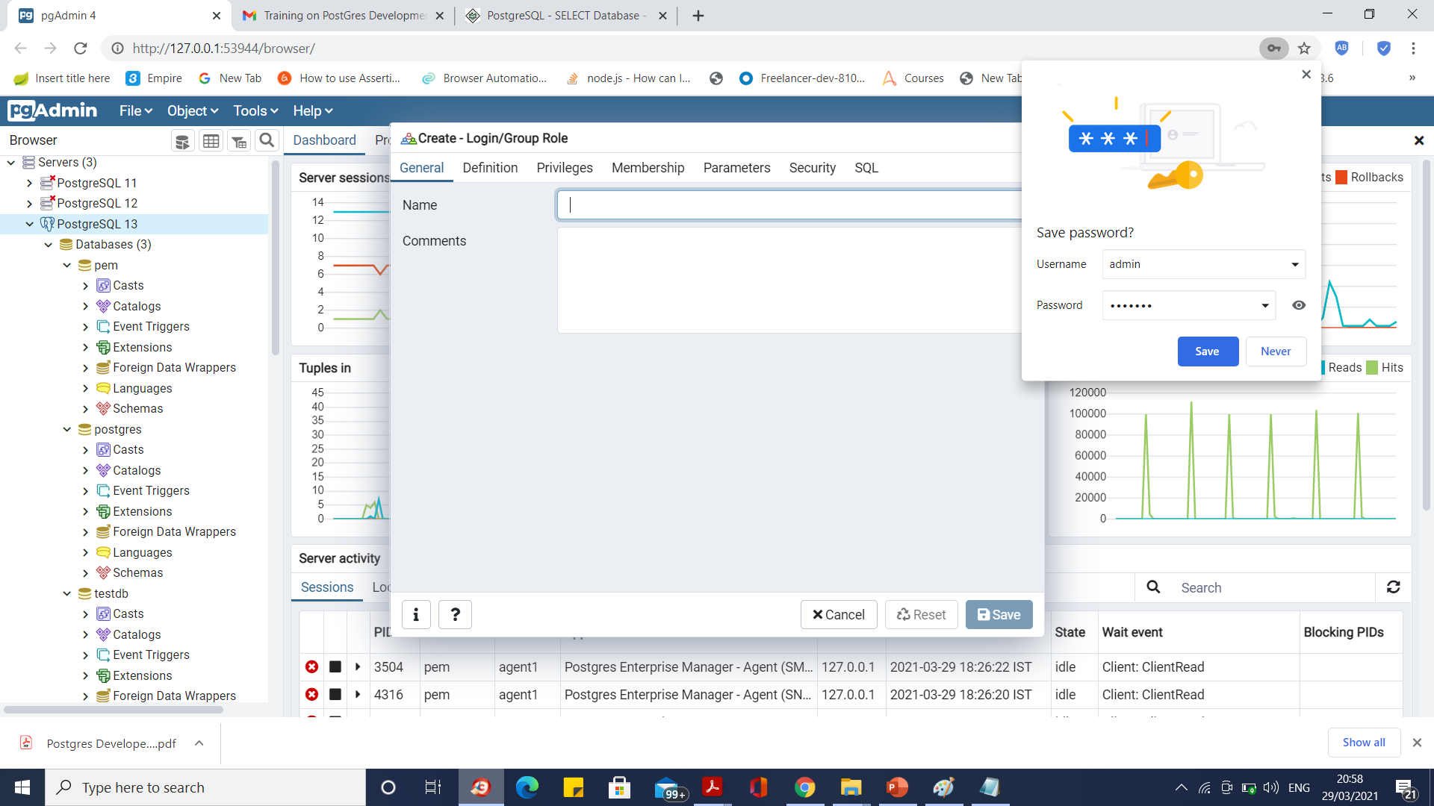
Database Cluster, Databases, and Tables

Slide 47
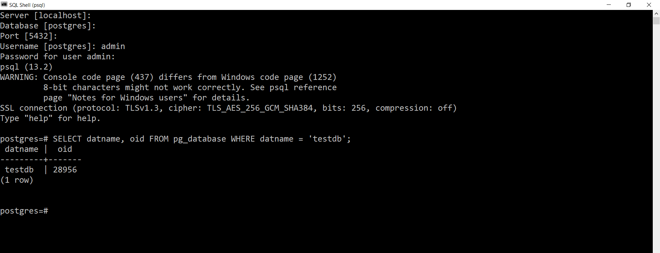
Database Cluster, Databases, and Tables

Slide 48
Physical Structure of Database Cluster
A database cluster basically is one directory referred to as base directory, and it contains some subdirectories and lots of files.
If we execute the initdb utility to initialize a new database cluster, a base directory will be created under the specified directory.
Path of the base directory is usually set to the environment variable PGDATA.

Slide 49
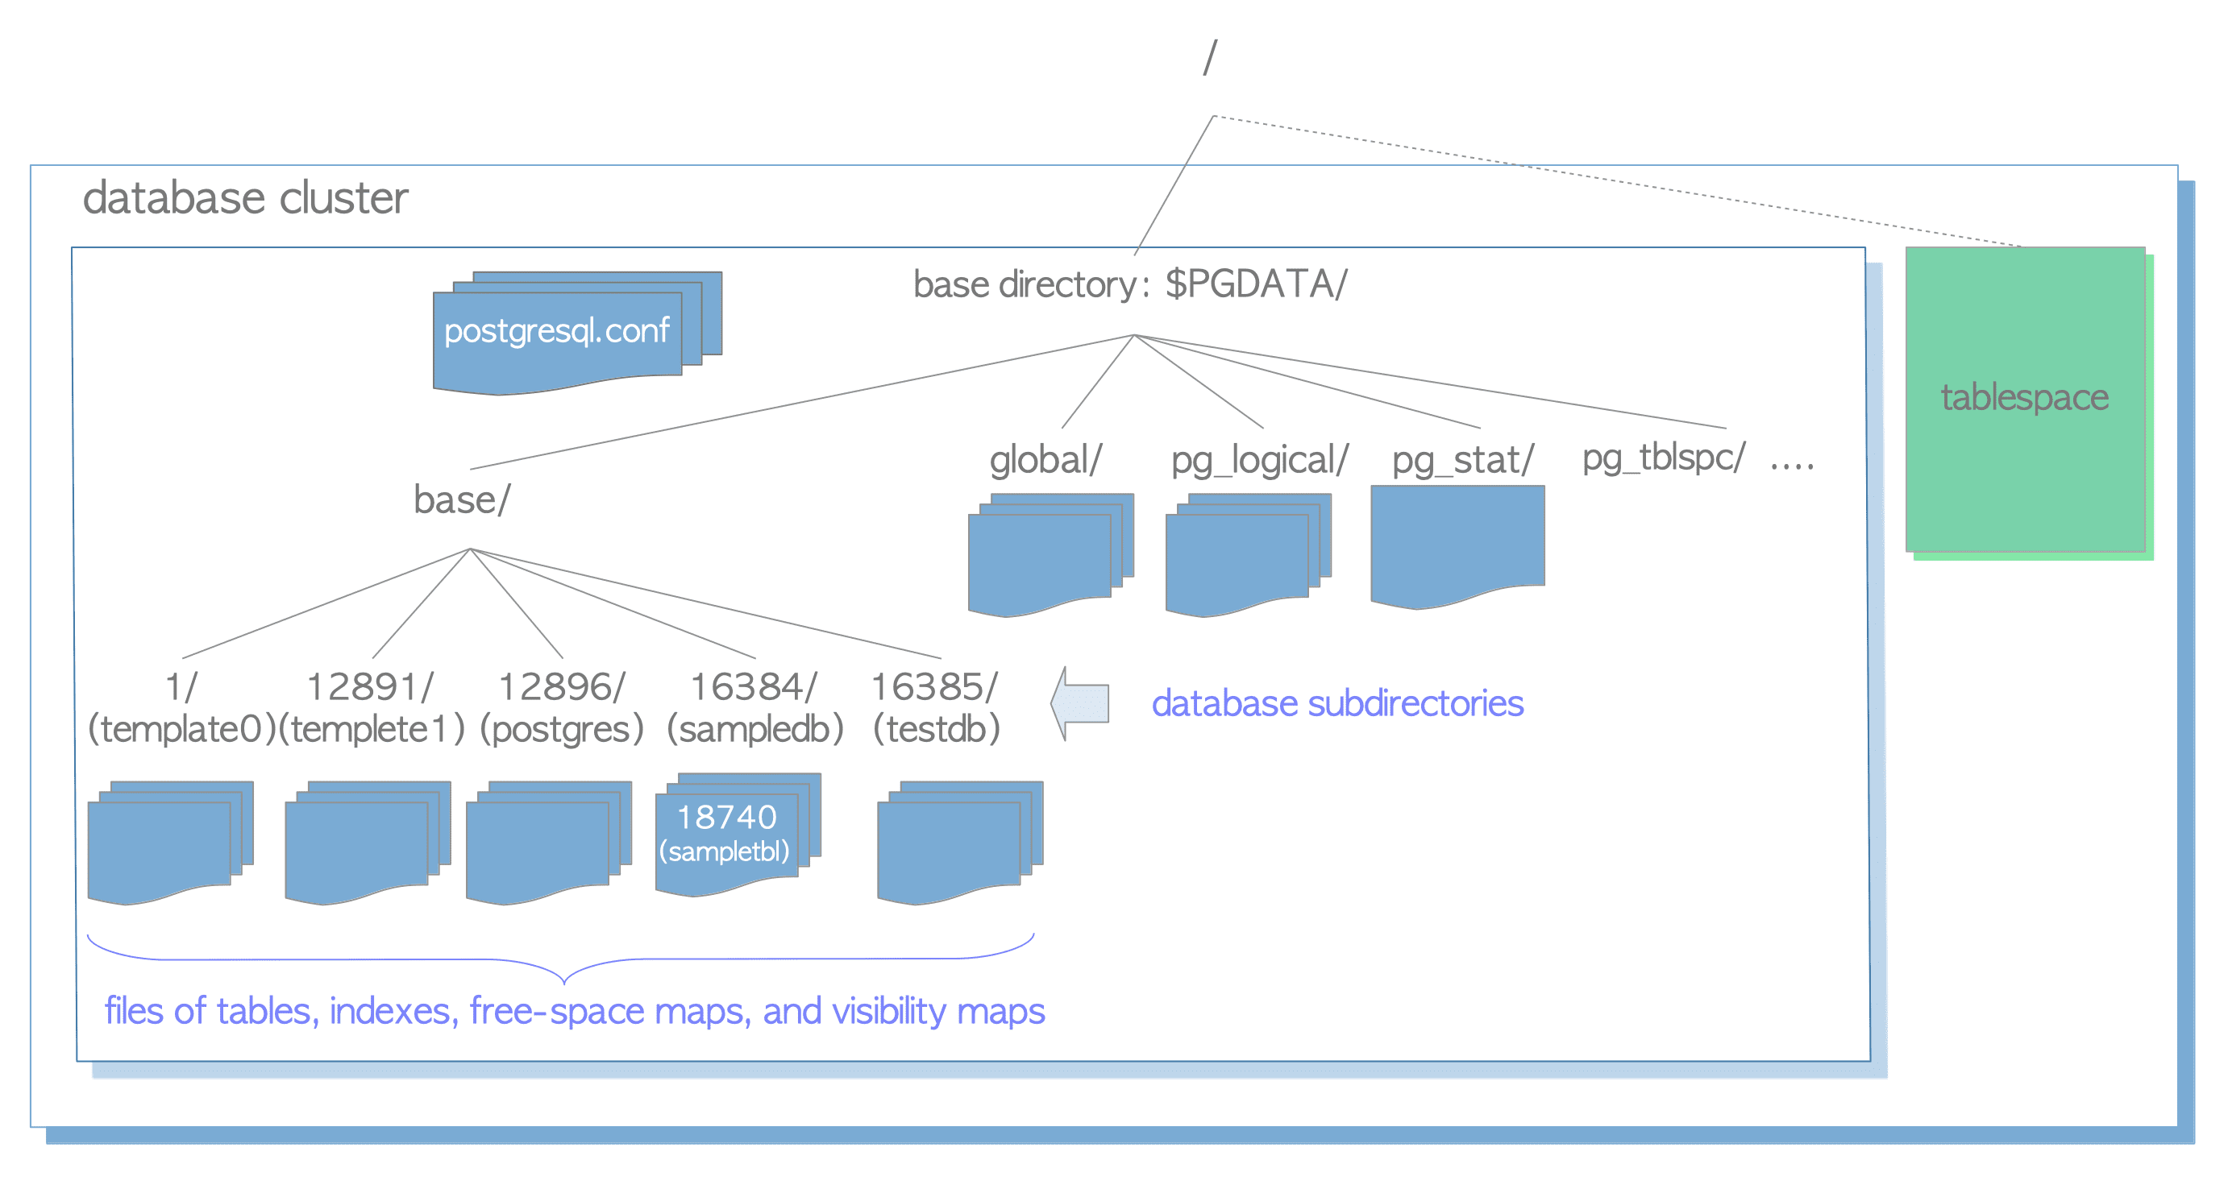
Physical Structure of Database Cluster

Slide 50
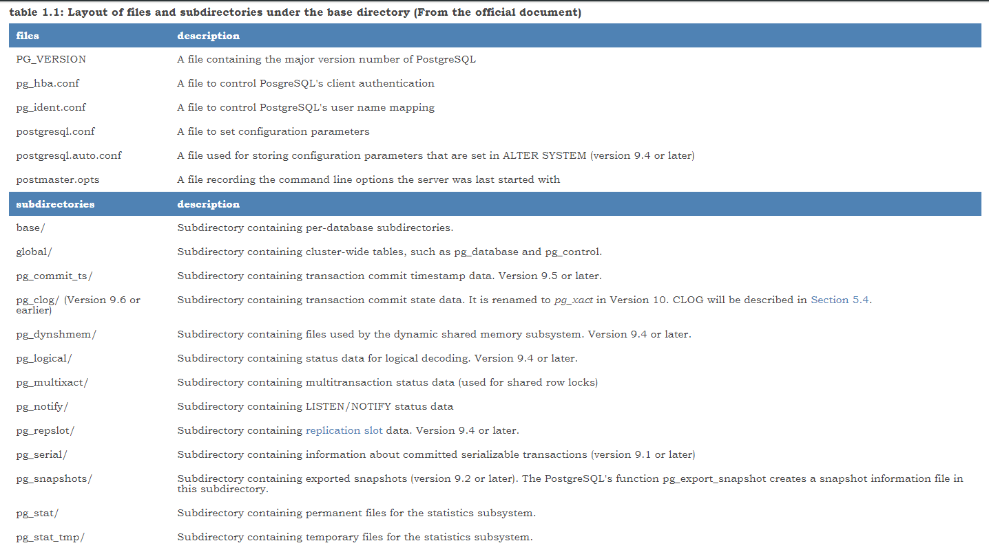
Layout of a Database Cluster

Slide 51
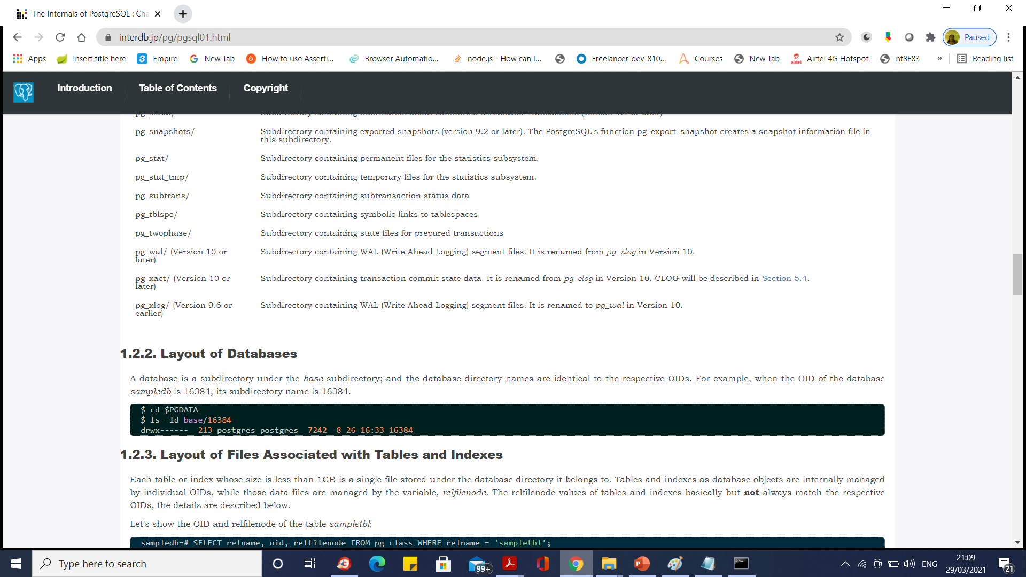
Layout of a Database Cluster

Slide 52
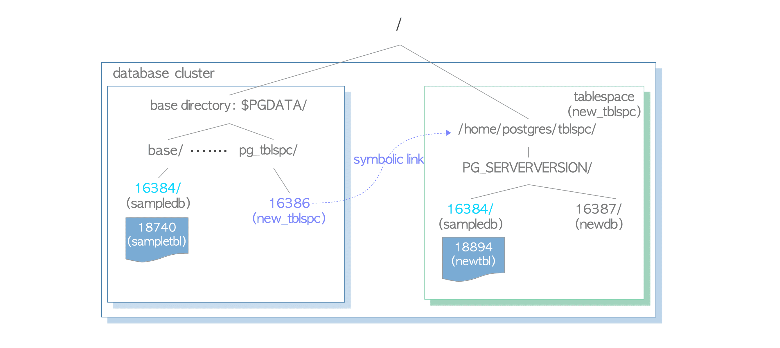
Tablespaces
A tablespace in PostgreSQL is an additional data area outside the base directory.
This function has been implemented in version 8.0.

Slide 53
Internal Layout of a Heap Table File
Inside the data file (heap table and index, as well as the free space map and visibility map), it is divided into pages (or blocks) of fixed length, the default is 8192 byte (8 KB).
Those pages within each file are numbered sequentially from 0, and such numbers are called as block numbers.
If the file has been filled up, PostgreSQL adds a new empty page to the end of the file to increase the file size.

Slide 54
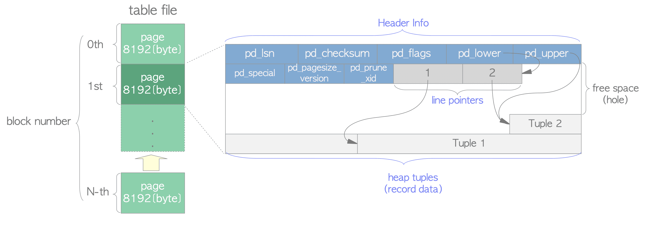
Internal Layout of a Heap Table File

Slide 55
Internal Layout of a Heap Table File
heap tuple(s) – A heap tuple is a record data itself. They are stacked in order from the bottom of the page
line pointer(s) – A line pointer is 4 byte long and holds a pointer to each heap tuple. It is also called an item pointer.
Line pointers form a simple array, which plays the role of index to the tuples. Each index is numbered sequentially from 1, and called offset number. When a new tuple is added to the page, a new line pointer is also pushed onto the array to point to the new one.

Slide 56
Internal Layout of a Heap Table File
header data – A header data defined by the structure PageHeaderData is allocated in the beginning of the page. It is 24 byte long and contains general information about the page.
The major variables of the structure are described below.
pd_lsn – This variable stores the LSN of XLOG record written by the last change of this page. It is an 8-byte unsigned integer, related to the WAL (Write-Ahead Logging) mechanism. The details are described in Chapter 9.
pd_checksum – This variable stores the checksum value of this page. (Note that this variable is supported in version 9.3 or later; in earlier versions, this part had stored the timelineId of the page.)

Slide 57
Internal Layout of a Heap Table File
pd_lower, pd_upper – pd_lower points to the end of line pointers, and pd_upper to the beginning of the newest heap tuple.
pd_special – This variable is for indexes. In the page within tables, it points to the end of the page. (In the page within indexes, it points to the beginning of special space which is the data area held only by indexes and contains the particular data according to the kind of index types such as B-tree, GiST, GiN, etc.)

Slide 58
Internal Layout of a Heap Table File
An empty space between the end of line pointers and the beginning of the newest tuple is referred to as free space or hole.
To identify a tuple within the table, tuple identifier (TID) is internally used.
A TID comprises a pair of values: the block number of the page that contains the tuple, and the offset number of the line pointer that points to the tuple.

Slide 59
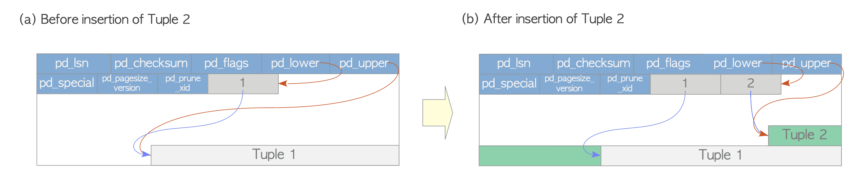
The Methods of Writing and Reading Tuples

Slide 60
The Methods of Writing and Reading Tuples
Writing Heap Tuples
Suppose a table composed of one page which contains just one heap tuple.
The pd_lower of this page points to the first line pointer, and both the line pointer and the pd_upper point to the first heap tuple.
When the second tuple is inserted, it is placed after the first one.
The second line pointer is pushed onto the first one, and it points to the second tuple.
The pd_lower changes to point to the second line pointer, and the pd_upper to the second heap tuple.

Slide 61
The Methods of Writing and Reading Tuples
Reading Heap Tuples
Two typical access methods, sequential scan and B-tree index scan, are outlined here:
Sequential scan – All tuples in all pages are sequentially read by scanning all line pointers in each page.
B-tree index scan – An index file contains index tuples, each of which is composed of an index key and a TID pointing to the target heap tuple.
If the index tuple with the key that you are looking for has been found, PostgreSQL reads the desired heap tuple using the obtained TID value.
It means that the target heap tuple is 2nd tuple in the 7th page within the table, so PostgreSQL can read the desired heap tuple without unnecessary scanning in the pages.

Slide 62
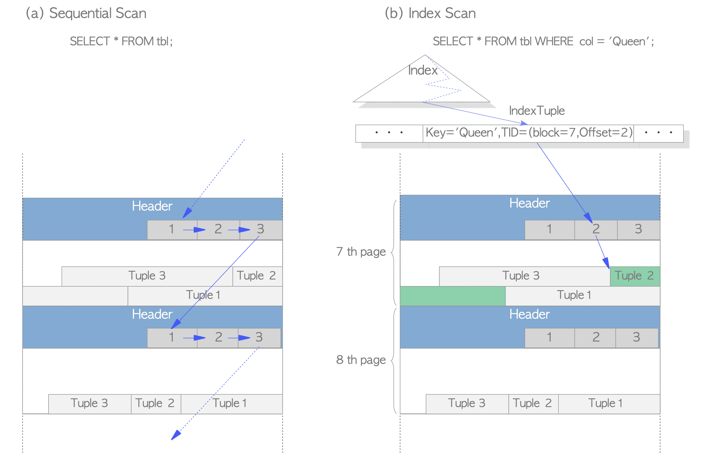
The Methods of Writing and Reading Tuples

Slide 63
Process and Memory Architecture
PostgreSQL is a client/server type relational database management system with the multi-process architecture and runs on a single host.
A collection of multiple processes cooperatively managing one database cluster is usually referred to as a 'PostgreSQL server', and it contains the following types of processes:
A postgres server process is a parent of all processes related to a database cluster management.
Each backend process handles all queries and statements issued by a connected client.
Various background processes perform processes of each feature (e.g., VACUUM and CHECKPOINT processes) for database management.
In the replication associated processes, they perform the streaming replication.
In the background worker process supported from version 9.3, it can perform any processing implemented by users. As not going into detail here, refer to the official document.

Slide 64
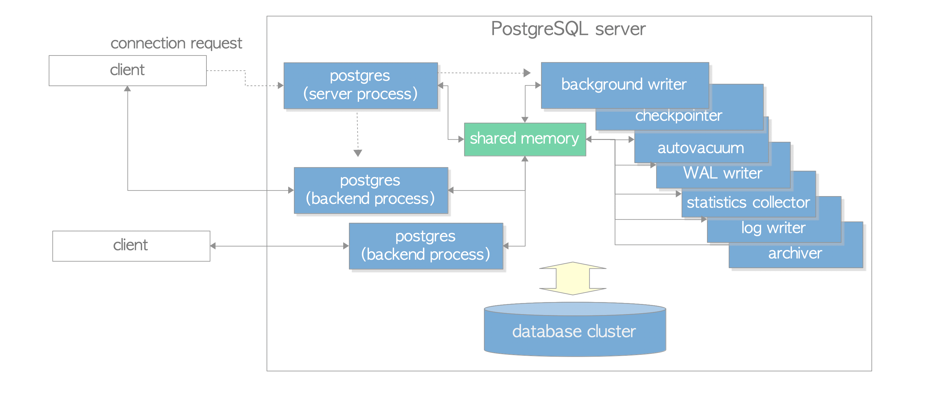
Process and Memory Architecture

Slide 65
Postgres Server Process
A postgres server process is a parent of all in a PostgreSQL server.
In the earlier versions, it was called ‘postmaster’.
By executing the pg_ctl utility with start option, a postgres server process starts up.
Then, it allocates a shared memory area in memory, starts various background processes, starts replication associated processes and background worker processes if necessary, and waits for connection requests from clients.
Whenever receiving a connection request from a client, it starts a backend process. (And then, the started backend process handles all queries issued by the connected client.)
A postgres server process listens to one network port, the default port is 5432. Although more than one PostgreSQL server can be run on the same host, each server should be set to listen to different port number in each other, e.g., 5432, 5433, etc.

Slide 66
Backend Processes
A backend process, which is also called postgres, is started by the postgres server process and handles all queries issued by one connected client.
It communicates with the client by a single TCP connection, and terminates when the client gets disconnected.
As it is allowed to operate only one database, you have to specify a database you want to use explicitly when connecting to a PostgreSQL server.
PostgreSQL allows multiple clients to connect simultaneously; the configuration parameter max_connections controls the maximum number of the clients (default is 100).
If many clients such as WEB applications frequently repeat the connection and disconnection with a PostgreSQL server, it increases both costs of establishing connections and of creating backend processes because PostgreSQL has not implemented a native connection pooling feature.
Such circumstance has a negative effect on the performance of database server. To deal with such a case, a pooling middleware (either pgbouncer or pgpool-II) is usually used.

Slide 67
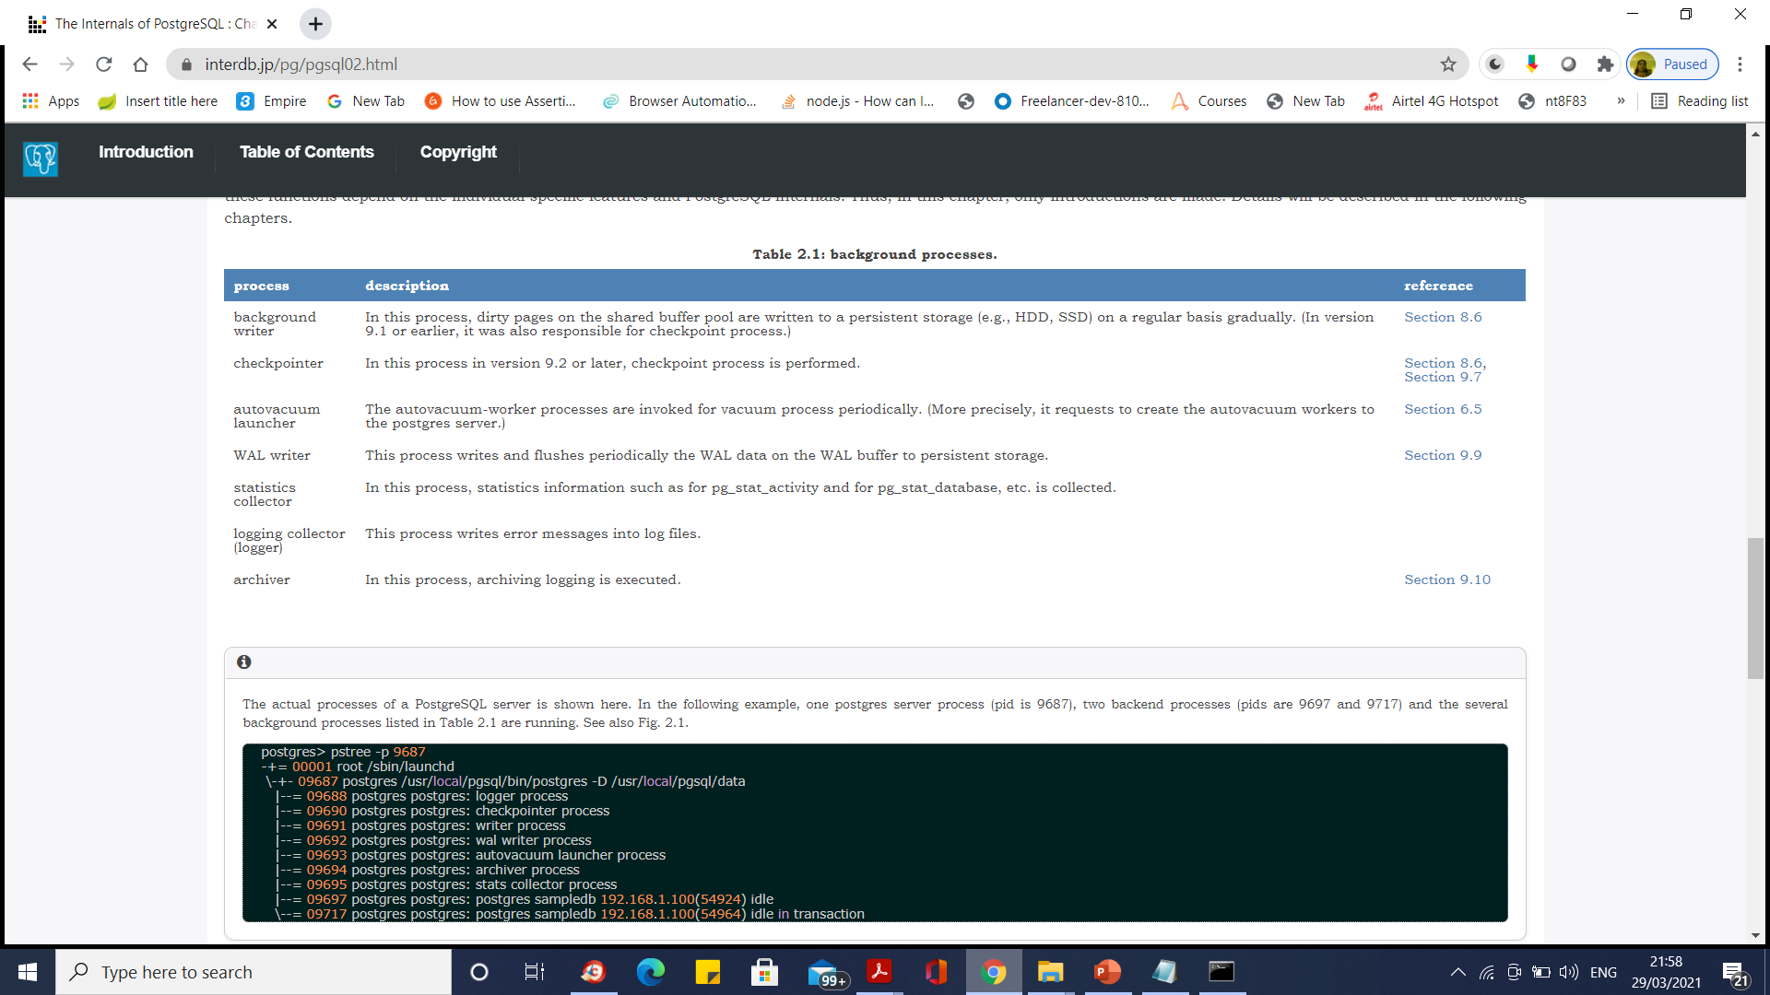
Backend Processes

Slide 68
Memory Architecture
Memory architecture in PostgreSQL can be classified into two broad categories:
Local memory area – allocated by each backend process for its own use.
Shared memory area – used by all processes of a PostgreSQL server.

Slide 69
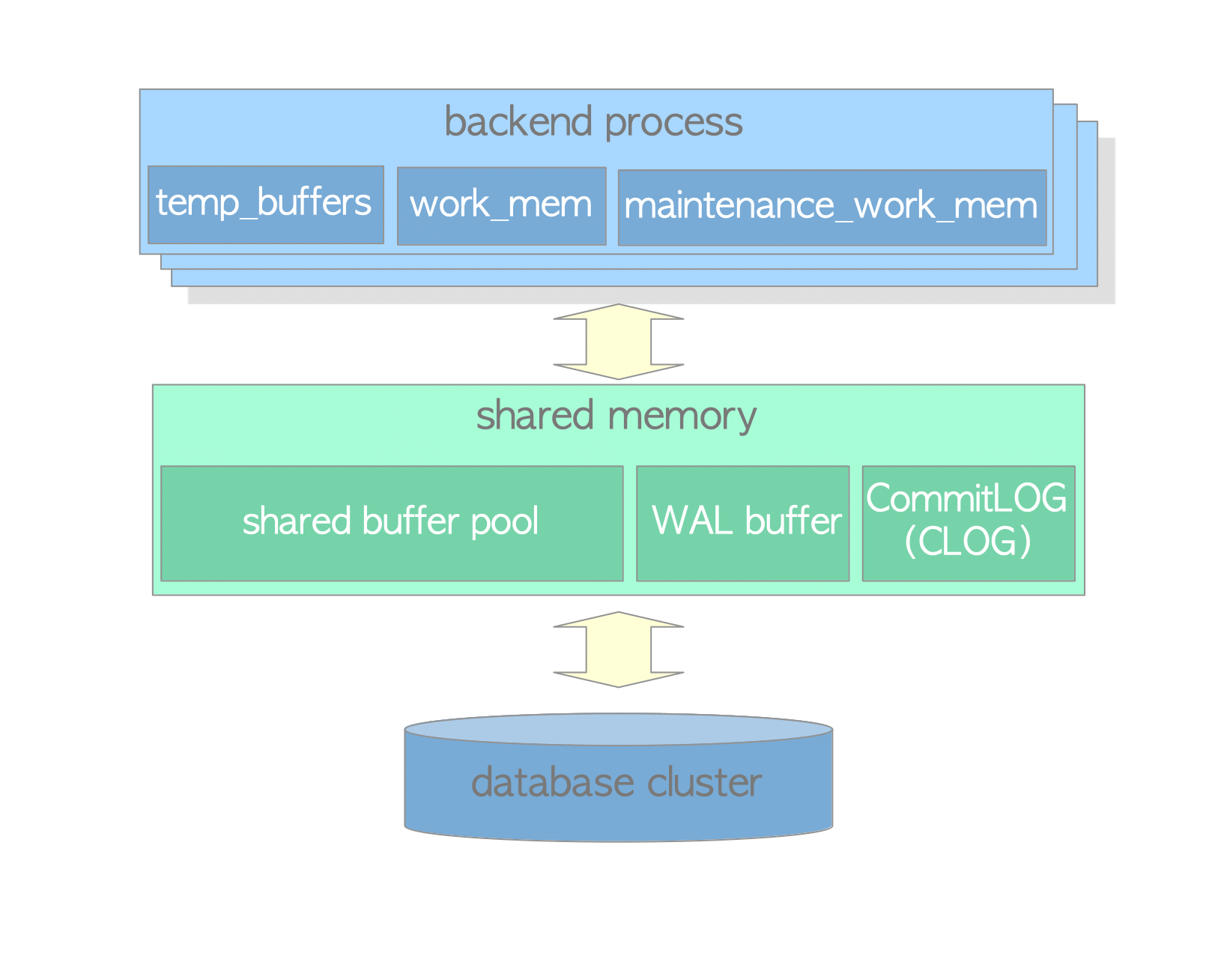
Memory Architecture

Slide 70
Memory Architecture
Local Memory Area
Each backend process allocates a local memory area for query processing; each area is divided into several sub-areas – whose sizes are either fixed or variable.
Shared Memory Area
A shared memory area is allocated by a PostgreSQL server when it starts up. This area is also divided into several fix sized sub-areas.

Slide 71
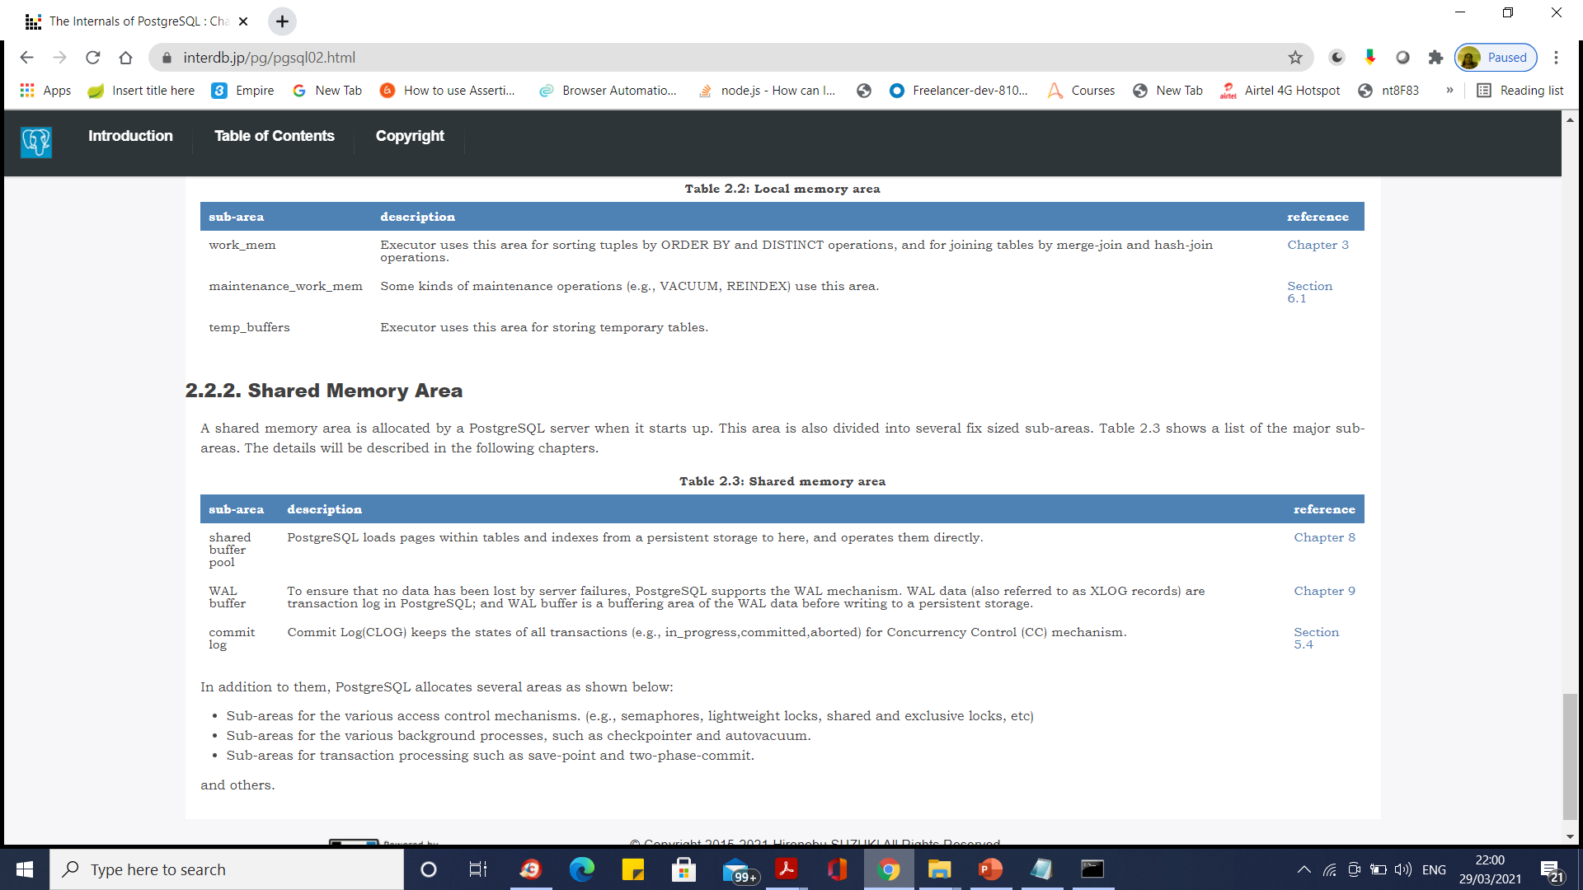
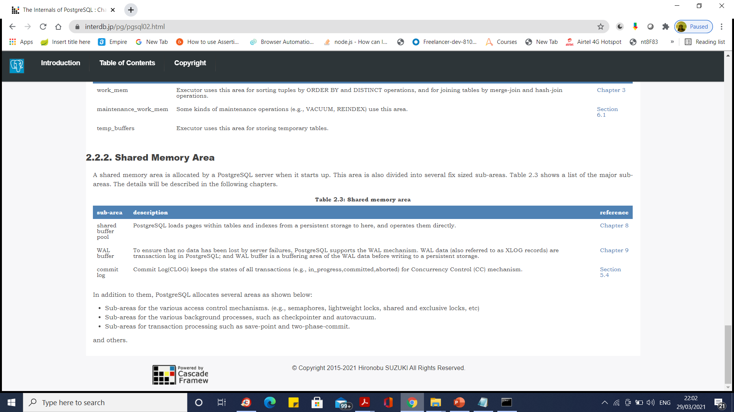
Memory Architecture

Slide 72
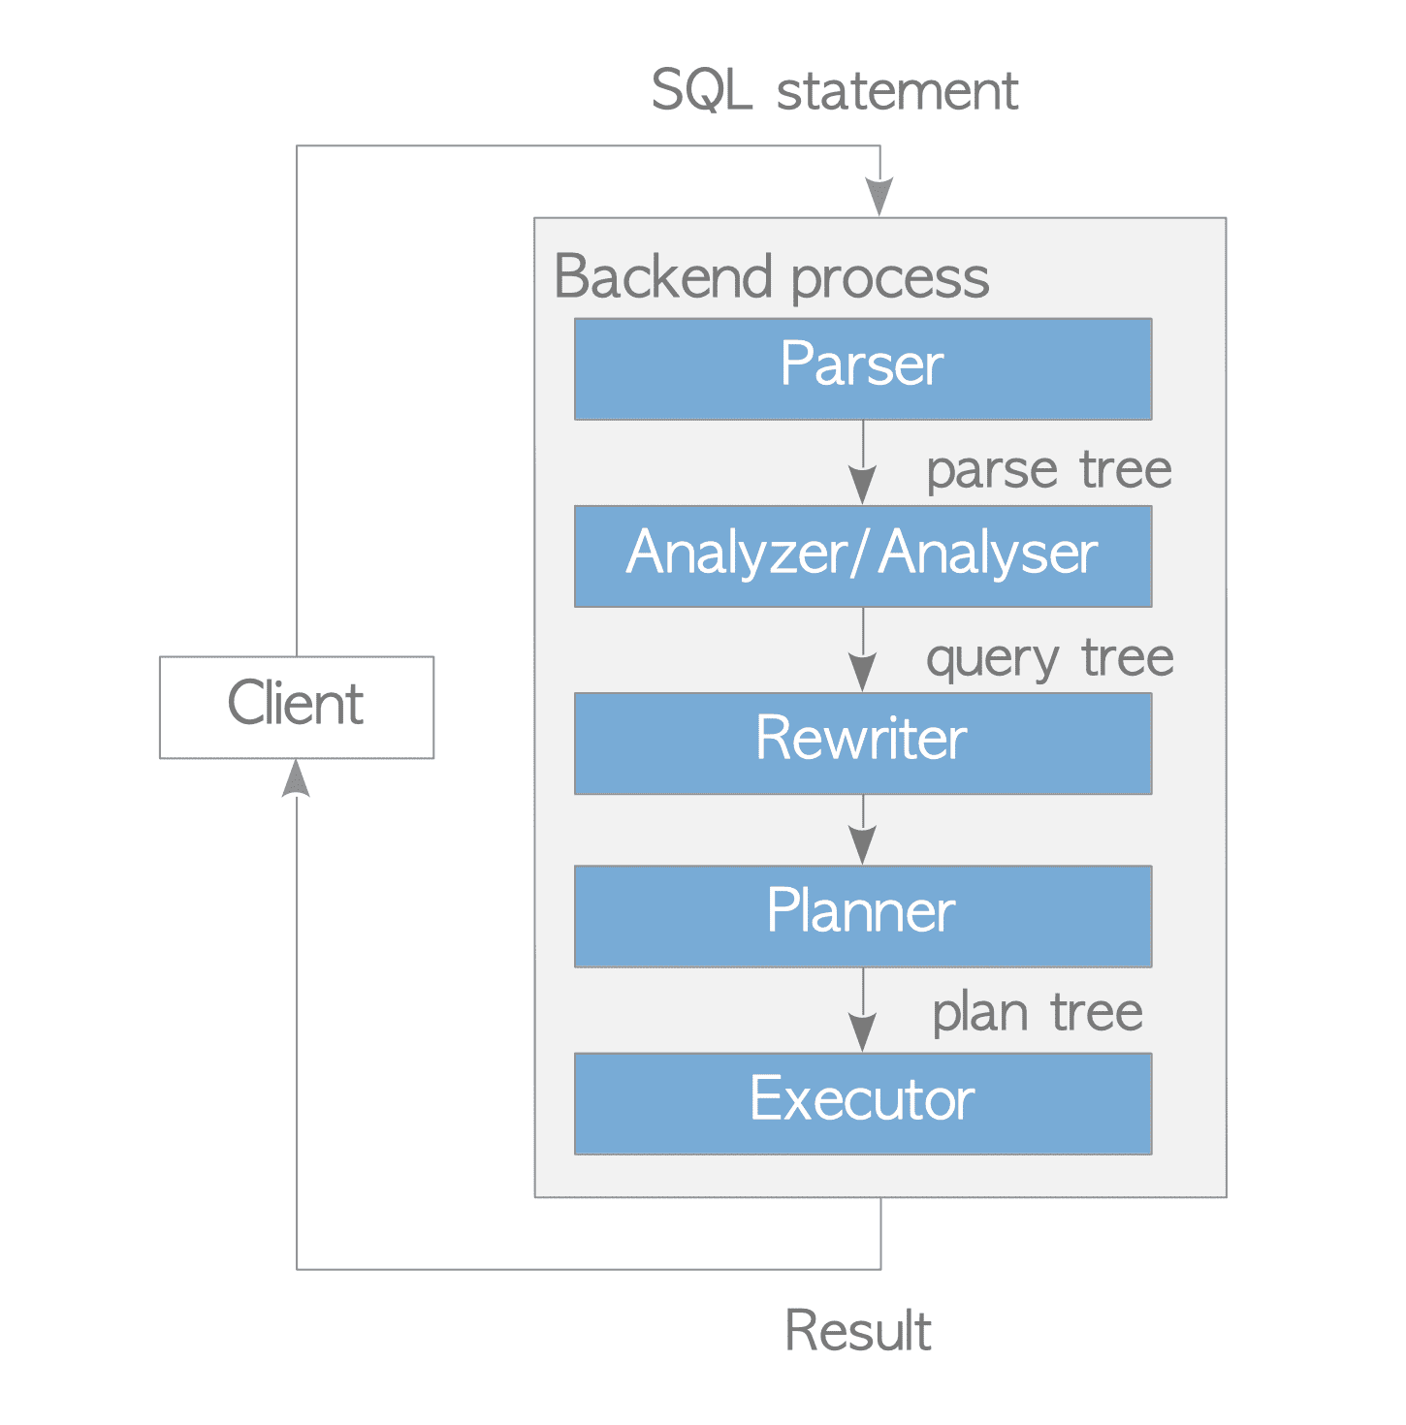
Query Processing

Slide 73
Query Processing
Parser
The parser generates a parse tree from an SQL statement in plain text.
Analyzer/Analyser
The analyzer/analyser carries out a semantic analysis of a parse tree and generates a query tree.
Rewriter
The rewriter transforms a query tree using the rules stored in the rule system if such rules exist.
Planner
The planner generates the plan tree that can most effectively be executed from the query tree.
Executor
The executor executes the query via accessing the tables and indexes in the order that was created by the plan tree.

Slide 74
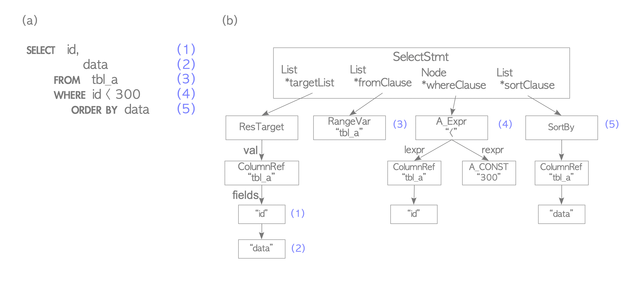
Query Processing
Parser
The parser generates a parse tree that can be read by subsequent subsystems from an SQL statement in plain text.

Slide 75
Query Processing
Analyzer/Analyser
The analyzer/analyser runs a semantic analysis of a parse tree generated by the parser and generates a query tree.
The root of a query tree is the Query structure defined in parsenodes.h; this structure contains metadata of its corresponding query such as the type of this command (SELECT, INSERT or others) and several leaves; each leaf forms a list or a tree and holds data of the individual particular clause.

Slide 76
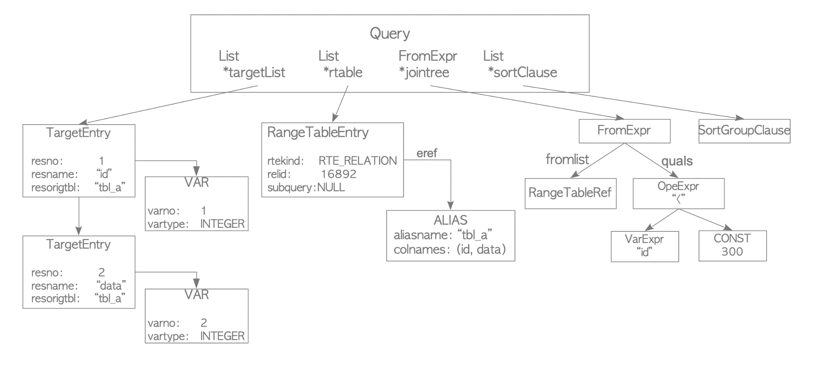
Query Processing

Slide 77
Query Processing
The target list is a list of columns that are the result of this query. In this example, this list is composed of two columns: ‘id' and ‘data’.
If the input query tree uses ‘∗' (asterisk), the analyzer/analyser will explicitly replace it to all of the columns.
The range table is a list of relations that are used in this query.
In this example, this table holds the information of the table ‘tbl_a’ such as the oid of this table and the name of this table.
The join tree stores the FROM clause and the WHERE clauses.
The sort clause is a list of SortGroupClause.

Slide 78
Architectural Fundamentals
In database jargon, PostgreSQL uses a client/server model.
A PostgreSQL session consists of the following cooperating processes (programs):
A server process, which manages the database files, accepts connections to the database from client applications, and performs database actions on behalf of the clients.
The database server program is called postgres.
The user's client (frontend) application that wants to perform database operations.
Client applications can be very diverse in nature: a client could be a text-oriented tool, a graphical application, a web server that accesses the database to display web pages, or a specialized database maintenance tool.
Some client applications are supplied with the PostgreSQL distribution; most are developed by users.

Slide 79
Architectural Fundamentals
As is typical of client/server applications, the client and the server can be on different hosts.
In that case they communicate over a TCP/IP network connection.
As files can be accessed on a client machine might not be accessible (or might only be accessible using a different file name) on the database server machine.

Slide 80
Architectural Fundamentals
The PostgreSQL server can handle multiple concurrent connections from clients.
To achieve this, it starts (“forks”) a new process for each connection.
From that point on, the client and the new server process communicate without intervention by the original postgres process.
Thus, the master server process is always running, waiting for client connections, whereas client and associated server processes come and go. (All of this is of course invisible to the user. We only mention it here for completeness.)

Slide 81
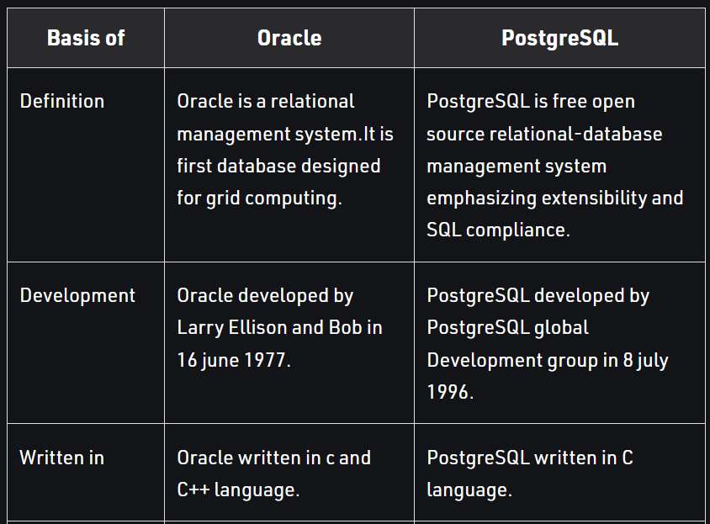
Postgre vs Oracle

Slide 82
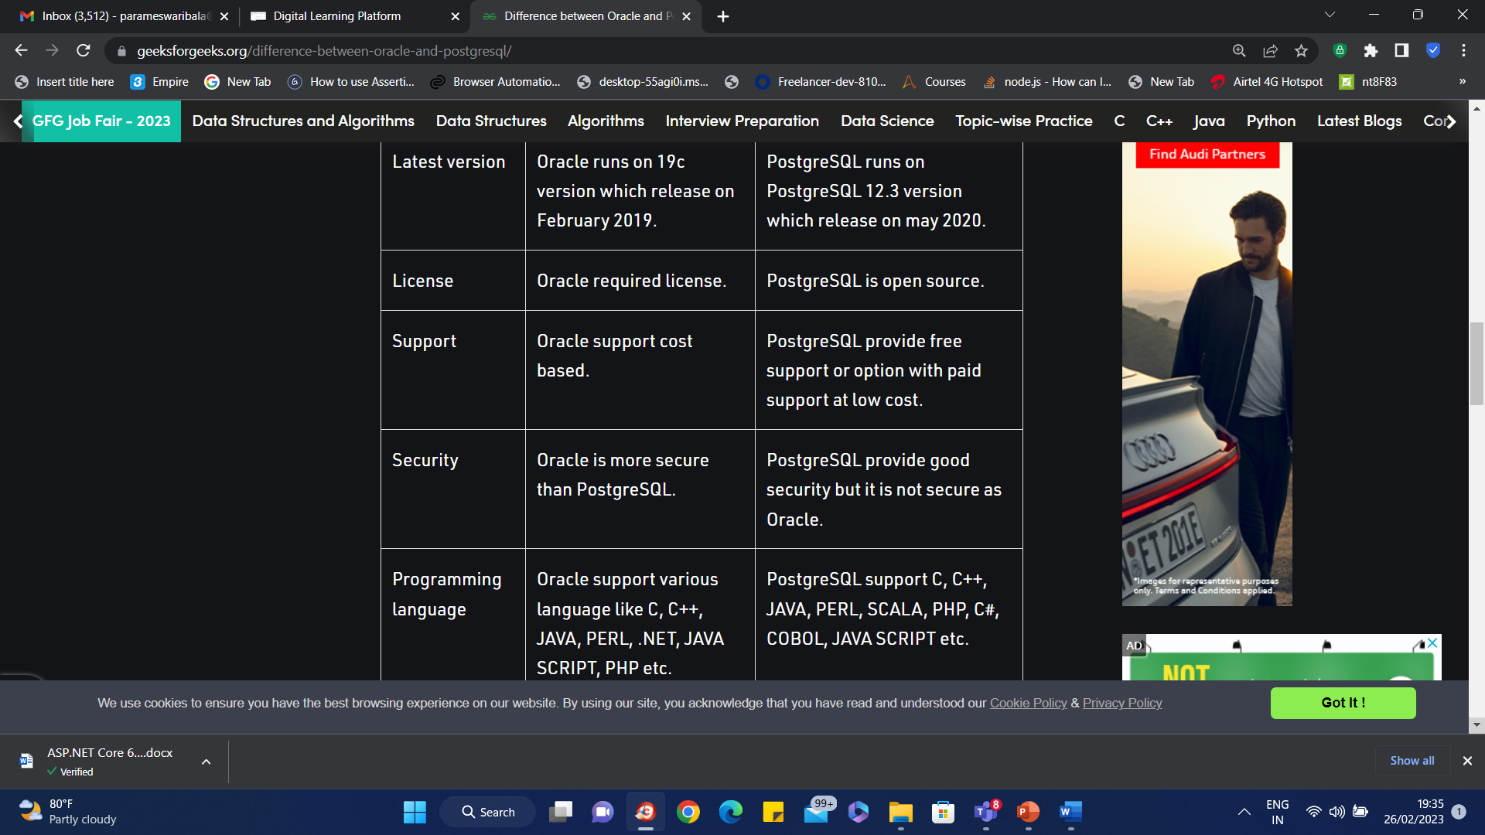
Postgre vs Oracle

Slide 83
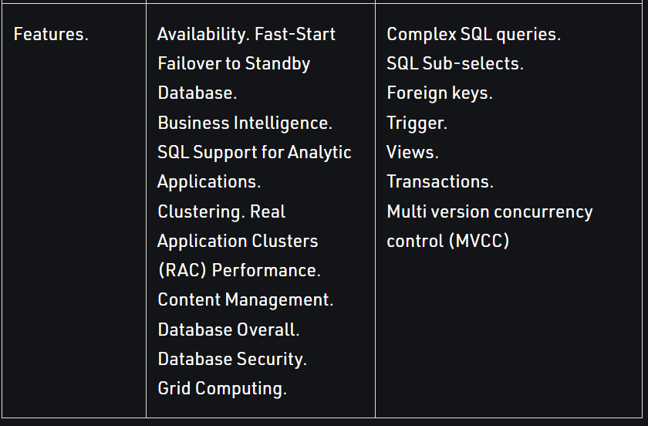
Postgre vs Oracle

Slide 84
Writing Simple Queries
Creating a Database
To create a new database, in this example named mydb, you use the following command:
$ create database mydb;
Accessing a Database
Running the PostgreSQL interactive terminal program, called psql, which allows you to interactively enter, edit, and execute SQL commands.
Using an existing graphical frontend tool like pgAdmin or an office suite with ODBC or JDBC support to create and manipulate a database.

Slide 85
Writing Simple Queries
Accessing a Database
\c mydb;

Slide 86
Writing Simple Queries

Slide 87
Data Types

Slide 88
Data Types

Slide 89
Data Types

Slide 90
Numeric Types

Slide 91
Monetary Types

Slide 92
Binary Input Type

Slide 93
Character Types

Slide 94
Boolean Type

Slide 95
Date/Time Types

Slide 96
Date/Time Types

Slide 97
Time Input

Slide 98
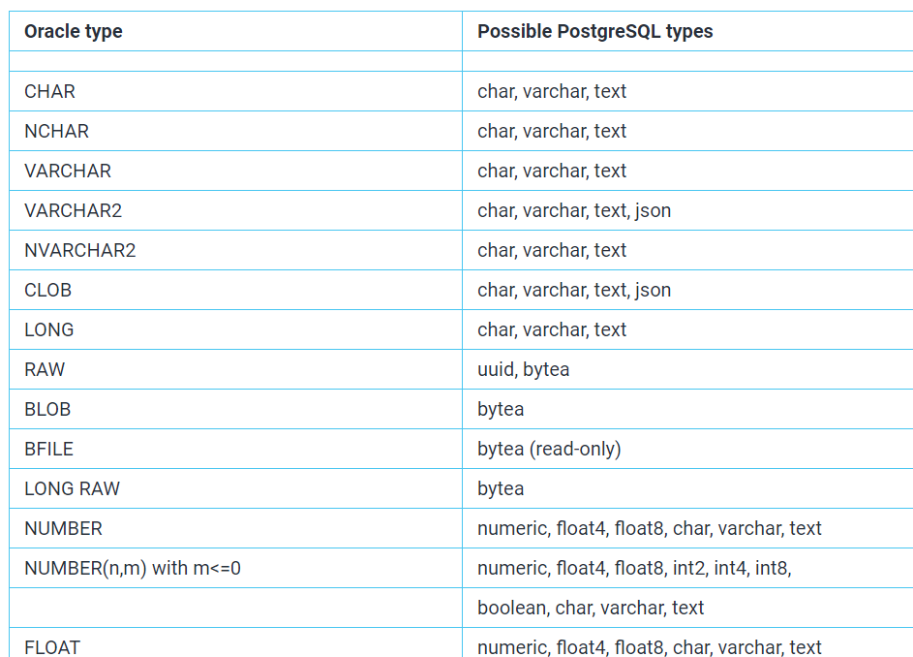
Oracle Data Types vs Postgre Data Types

Slide 99
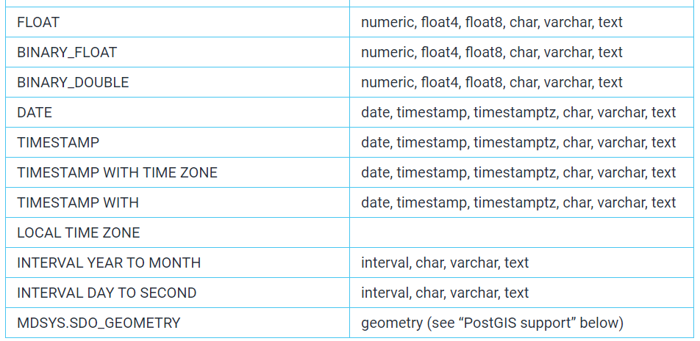
Oracle Data Types vs Postgre Data Types

Slide 100
Enumerated Type

Slide 101
Geometric Types

Slide 102
Geometric Types
CREATE EXTENSION postgis;
CREATE TABLE geometries (name varchar, geom geometry);
INSERT INTO geometries VALUES
('Point', 'POINT(0 0)'),
('Linestring', 'LINESTRING(0 0, 1 1, 2 1, 2 2)'),
('Polygon', 'POLYGON((0 0, 1 0, 1 1, 0 1, 0 0))'),
('PolygonWithHole', 'POLYGON((0 0, 10 0, 10 10, 0 10, 0 0),(1 1, 1 2, 2 2, 2 1, 1 1))'),
('Collection', 'GEOMETRYCOLLECTION(POINT(2 0),POLYGON((0 0, 1 0, 1 1, 0 1, 0 0)))');
SELECT name, ST_AsText(geom) FROM geometries;

Slide 103
Network Address Types

Slide 104
Network Address Types
CREATE TABLE inet_test (
address INET
);
INSERT INTO inet_test (address) VALUES ('198.24.10.0/24');
INSERT INTO inet_test (address) VALUES ('198.24.10.0');
INSERT INTO inet_test (address) VALUES ('198.10/8');

Slide 105
cidr Type Input

Slide 106
Bit String Types
Bit strings are strings of 1's and 0's. They can be used to store or visualize bit masks.
There are two SQL bit types: bit(n) and bit varying(n), where n is a positive integer.
bit type data must match the length n exactly; it is an error to attempt to store shorter or longer bit strings.
bit varying data is of variable length up to the maximum length n; longer strings will be rejected.
Writing bit without a length is equivalent to bit(1), while bit varying without a length specification means unlimited length.

Slide 107
Bit String Types

Slide 108
UUID Type
The data type uuid stores Universally Unique Identifiers (UUID) as defined by RFC 4122, ISO/IEC 9834-8:2005, and related standards.
(This identifier is a 128-bit quantity that is generated by an algorithm chosen to make it very unlikely that the same identifier will be generated by anyone else in the known universe using the same algorithm.
Therefore, for distributed systems, these identifiers provide a better uniqueness guarantee than sequence generators, which are only unique within a single database.

Slide 109
UUID Type
PostgreSQL also accepts the following alternative forms for input: use of upper-case digits, the standard format surrounded by braces, omitting some or all hyphens, adding a hyphen after any group of four digits.
Examples are:
A0EEBC99-9C0B-4EF8-BB6D-6BB9BD380A11
{a0eebc99-9c0b-4ef8-bb6d-6bb9bd380a11}
a0eebc999c0b4ef8bb6d6bb9bd380a11
a0ee-bc99-9c0b-4ef8-bb6d-6bb9-bd38-0a11
{a0eebc99-9c0b4ef8-bb6d6bb9-bd380a11}

Slide 110
UUID Type
CREATE EXTENSION IF NOT EXISTS "uuid-ossp";
SELECT uuid_generate_v1();
SELECT uuid_generate_v4();
CREATE TABLE contacts (
contact_id uuid DEFAULT uuid_generate_v4 (),
first_name VARCHAR NOT NULL,
last_name VARCHAR NOT NULL,
email VARCHAR NOT NULL,
phone VARCHAR,
PRIMARY KEY (contact_id)
);

Slide 111
UUID Type
INSERT INTO contacts (
first_name,
last_name,
email,
phone
)
VALUES
(
'John',
'Smith',
'john.smith@example.com',
'408-237-2345'
),

Slide 112
UUID Type
(
'Jane',
'Smith',
'jane.smith@example.com',
'408-237-2344'
),
(
'Alex',
'Smith',
'alex.smith@example.com',
'408-237-2343'
);

Slide 113
XML Type
The xml data type can be used to store XML data.
Its advantage over storing XML data in a text field is that it checks the input values for well-formedness, and there are support functions to perform type-safe operations on it;
Use of this data type requires the installation to have been built with configure --with-libxml.

Slide 114
XML Type
The xml type can store well-formed “documents”, as defined by the XML standard, as well as “content” fragments, which are defined by reference to the more permissive “document node”1 of the XQuery and XPath data model.
Roughly, this means that content fragments can have more than one top-level element or character node.
The expression xmlvalue IS DOCUMENT can be used to evaluate whether a particular xml value is a full document or only a content fragment.

Slide 115
XML Type

Slide 116
Xml Type

Slide 117
JSON Types
JSON data types are for storing JSON (JavaScript Object Notation) data, as specified in RFC 71592.
Such data can also be stored as text, but the JSON data types have the advantage of enforcing that each stored value is valid according to the JSON rules.
There are also assorted JSON-specific functions and operators available for data stored in these data types;
PostgreSQL offers two types for storing JSON data: json and jsonb.

Slide 118
JSON Types
The json and jsonb data types accept almost identical sets of values as input.
The major practical difference is one of efficiency.
The json data type stores an exact copy of the input text, which processing functions must reparse on each execution; while jsonb data is stored in a decomposed binary format that makes it slightly slower to input due to added conversion overhead, but significantly faster to process, since no reparsing is needed.
jsonb also supports indexing, which can be a significant advantage.

Slide 119
JSON Types
Because the json type stores an exact copy of the input text, it will preserve semantically-insignificant white space between tokens, as well as the order of keys within JSON objects.
Also, if a JSON object within the value contains the same key more than once, all the key/value pairs are kept.
By contrast, jsonb does not preserve white space, does not preserve the order of object keys, and does not keep duplicate object keys.
If duplicate keys are specified in the input, only the last value is kept.
In general, most applications should prefer to store JSON data as jsonb, unless there are quite specialized needs, such as legacy assumptions about ordering of object keys.

Slide 120
JSON Types

Slide 121
Arrays

Slide 122
Sequence
CREATE [ TEMPORARY | TEMP ] SEQUENCE [ IF NOT EXISTS ] name
[ AS data_type ]
[ INCREMENT [ BY ] increment ]
[ MINVALUE minvalue | NO MINVALUE ] [ MAXVALUE maxvalue | NO MAXVALUE ]
[ START [ WITH ] start ] [ CACHE cache ] [ [ NO ] CYCLE ]
[ OWNED BY { table_name.column_name | NONE } ]

Slide 123
Sequence Parameters
TEMPORARY or TEMP — PostgreSQL can create a temporary sequence within a session. Once the session ends, the sequence is automatically dropped.
IF NOT EXISTS — Creates a sequence even if a sequence with an identical name already exists. Replaces the existing sequence.
AS — A new option in PostgreSQL 10. It is for specifying the data type of the sequence. The available options are smallint, integer, and bigint (default). This also determines the maximum and minimum values.
INCREMENT BY — An optional parameter with a default value of 1. Positive values generate sequence values in ascending order. Negative values generate sequence values in descending sequence.

Slide 124
Sequence Parameters
START WITH — The same as Oracle. This is an optional parameter having a default of 1. It uses the MINVALUE for ascending sequences and the MAXVALUE for descending sequences.
MAXVALUE | NO MAXVALUE — Defaults are between 263 for ascending sequences and -1 for descending sequences.
MINVALUE | NO MINVALUE — Defaults are between 1 for ascending sequences and -263 for descending sequences.
CYCLE | NO CYCLE — If the sequence value reaches MAXVALUE or MINVALUE, the CYCLE parameter instructs the sequence to return to the initial value (MINVALUE or MAXVALUE). The default is NO CYCLE.

Slide 125
Sequence Parameters
CACHE — Note that in PostgreSQL, the NOCACHE isn’t supported. By default, when not specifying the CACHE parameter, no sequence values will be pre-cached into memory, which is equivalent to the Oracle NOCACHE parameter. The minimum value is 1.
OWNED BY | OWNBY NON — Specifies that the sequence object is to be associated with a specific column in a table, which isn’t supported by Oracle. When dropping this type of sequence, an error will be returned because of the sequence/table association.

Slide 126
Arrays

Slide 127
Accessing Arrays

Slide 128
Accessing Arrays

Slide 129
Accessing Arrays

Slide 130
Modifying Arrays

Slide 131
Modifying Arrays

Slide 132
Modifying Arrays

Slide 133
Searching in Arrays

Slide 134
Searching in Arrays

Slide 135
Composite Types
A composite type represents the structure of a row or record; it is essentially just a list of field names and their data types.
PostgreSQL allows composite types to be used in many of the same ways that simple types can be used.
For example, a column of a table can be declared to be of a composite type.

Slide 136
Declaration of Composite Types

Slide 137
Constructing Composite Values
To write a composite value as a literal constant, enclose the field values within parentheses and separate them by commas.
We can put double quotes around any field value, and must do so if it contains commas or parentheses.
Thus, the general format of a composite constant is the following:
'( val1 , val2 , ... )'

Slide 138
Constructing Composite Values

Slide 139
Accessing Composite Types

Slide 140
Built in Range Types
int4range — Range of integer
int8range — Range of bigint
numrange — Range of numeric
tsrange — Range of timestamp without time zone
tstzrange — Range of timestamp with time zone
daterange — Range of date

Slide 141
Built in Range Types

Slide 142
PostgreSQL Full Text Search Entities
Document: A set of data on which your full-text search will take place is called Document.
In PostgreSQL, you can create a document using either a single column or multiple columns or even using multiple tables.
Lexemes: The PostgreSQL document during processing is parsed into multiple tokens, which consist of words, sentences, etc. of the text present in the document.
These tokens are modified to form more meaningful entities called lexemes.

Slide 143
PostgreSQL Full Text Search Entities
Dictionaries: The conversion of Tokens into Lexemes is done using dictionaries.
PostgreSQL offers both options of either using the built-in dictionaries or creating your own dictionaries.
These dictionaries are responsible to determine which stop words are not important and whether differently derived words have the same base language.

Slide 144
to_tsvector
To create a vector for a sentence, you can use the to_tsvector function as follows:
SELECT to_tsvector('The quick brown fox jumped over the lazy dog.’);
to_tsvector -----'brown':3 'dog':9 'fox':4 'jump':5 'lazi':8 'quick':2

Slide 145
to_tsquery
This function accepts a list of words that would be checked against the normalized vector created with the to_tsvector() function.
You can use the following Postgres functions to convert text fields to tsquery values such as to_tsquery, plainto_tsquery, and phraseto_tsquery.
SELECT to_tsquery('The quick brown fox jumped over the lazy dog')

Slide 146
Searching
After creating tsvector from your text data and tsquery from your search terms, you can further perform a full-text search using the @@ operator.
@@ operator checks if tsquery matches tsvector.
For instance, if the word to be queried is “fox” for the above-mentioned example, then:
SELECT to_tsvector('The quick brown fox jumped over the lazy dog') @@ to_tsquery('fox’);
Refer courses table in queries.txt

Slide 147
The SQL Language
Creating a New Table
CREATE TABLE weather (
city varchar(80),
temp_lo int, -- low temperature
temp_hi int, -- high temperature
prcp real, -- precipitation
date date
);

Slide 148
Populating a Table With Rows
The INSERT statement is used to populate a table with rows:
INSERT INTO weather VALUES ('San Francisco', 46, 50, 0.25, '1994-11-27');
Note that all data types use rather obvious input formats.
Constants that are not simple numeric values usually must be surrounded by single quotes ('), as in the example

Slide 149
Views
A VIEW is a pseudo table in PostgreSQL; it is not a solid table but appears as an ordinary table to select.
A view can also represent joined tables.
It can contain all rows of a table or selected rows from one or more tables.
A View simplifies users to perform the following aspects:
It structures data naturally and intuitively and makes it easy to find.
We can authorize permission to users over a view, which has a complete record that the users are authorized to see.
It restricts access to the data such that users can only see limited data instead of complete data.
A view provides a dependable layer, even the columns of necessary table modification.
It summarizes data from various tables to generate reports.
A view helps us to describe the difficulty of a statement as we can write a command of view based on a complex query with the help of a SELECT command.

Slide 150
Views
CREATE [OR REPLACE] VIEW view-name AS
SELECT column(s)
FROM table(s)
[WHERE condition(s)];
CREATE VIEW Price_View AS
SELECT id, price
FROM Price
WHERE price > 200;

Slide 151
Clear the screen
\! cls

Slide 152
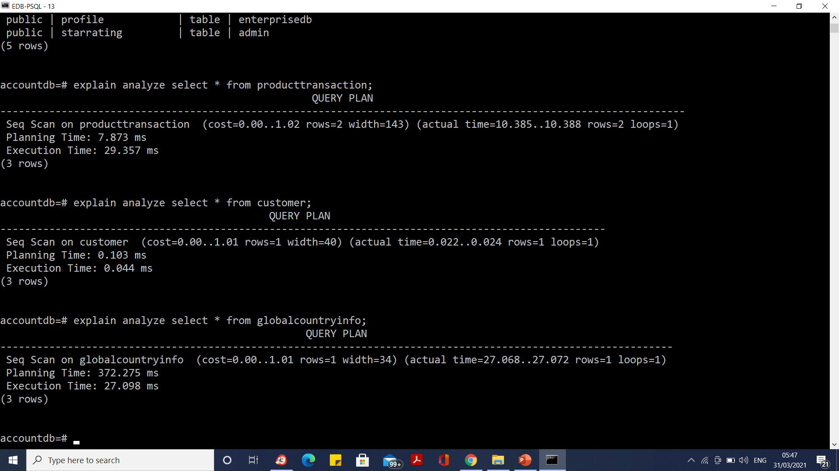
Explain and Analyze

Slide 153
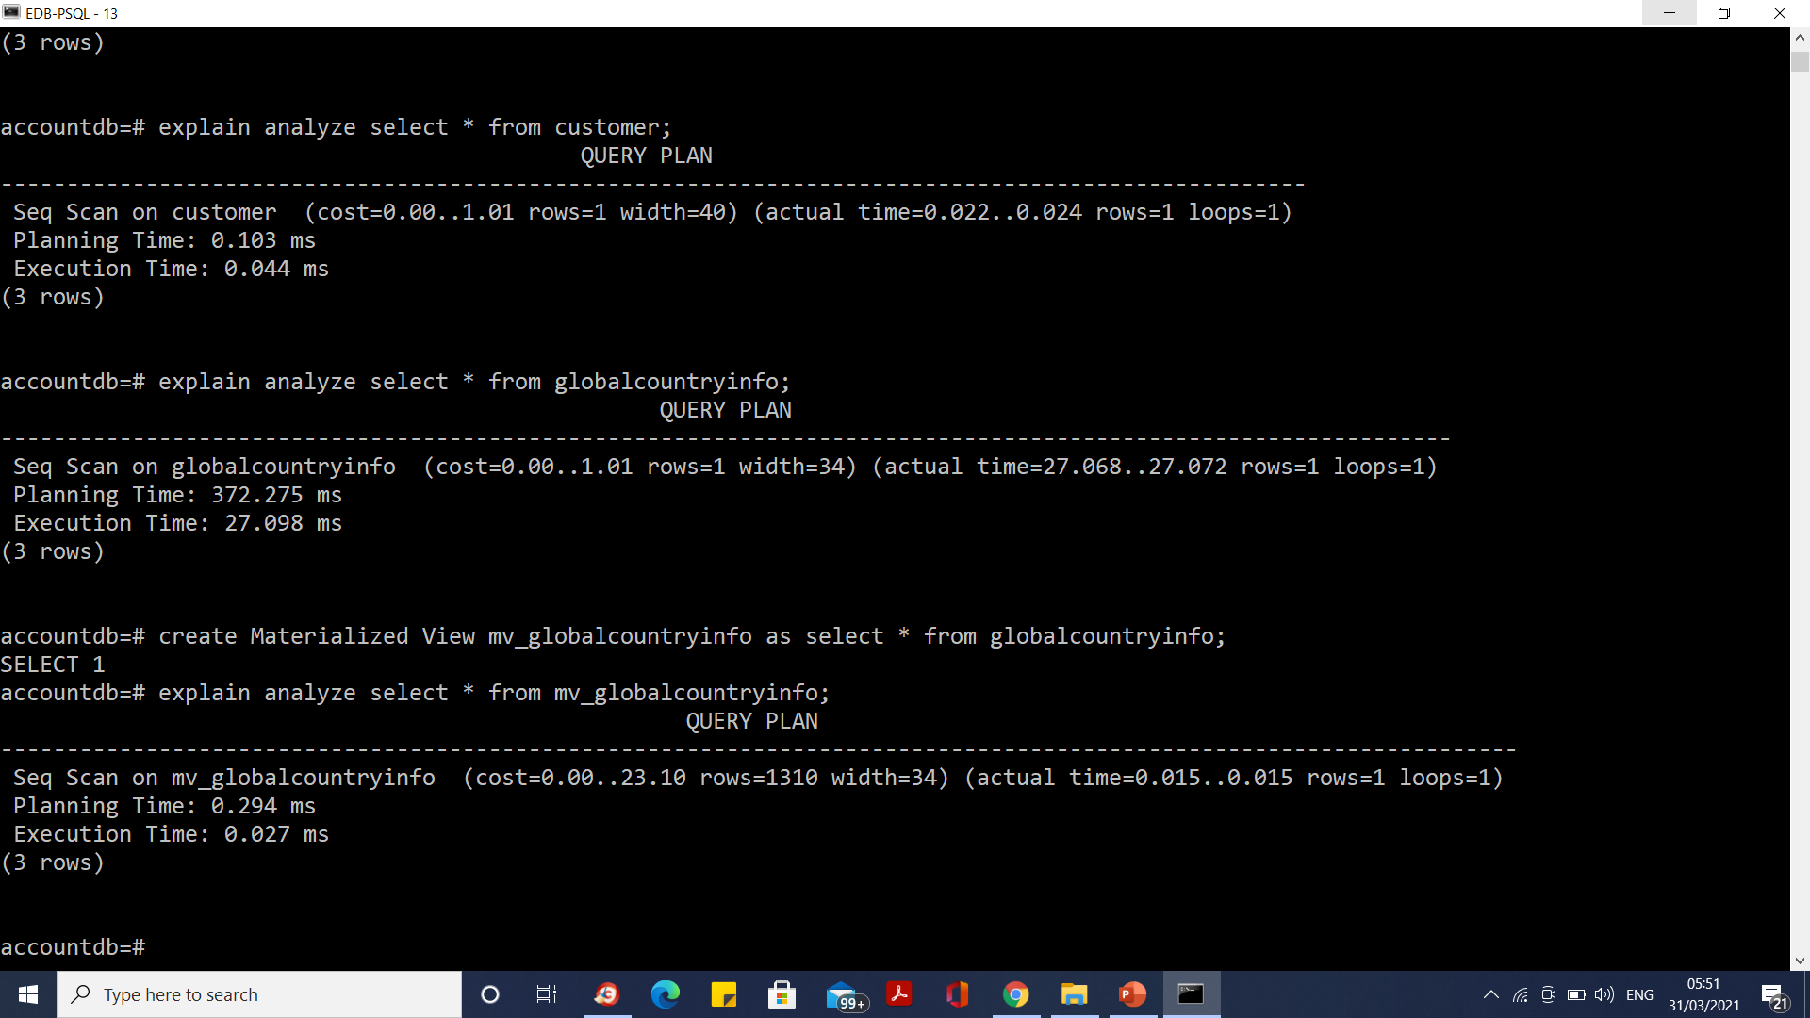
Materialized View

Slide 154
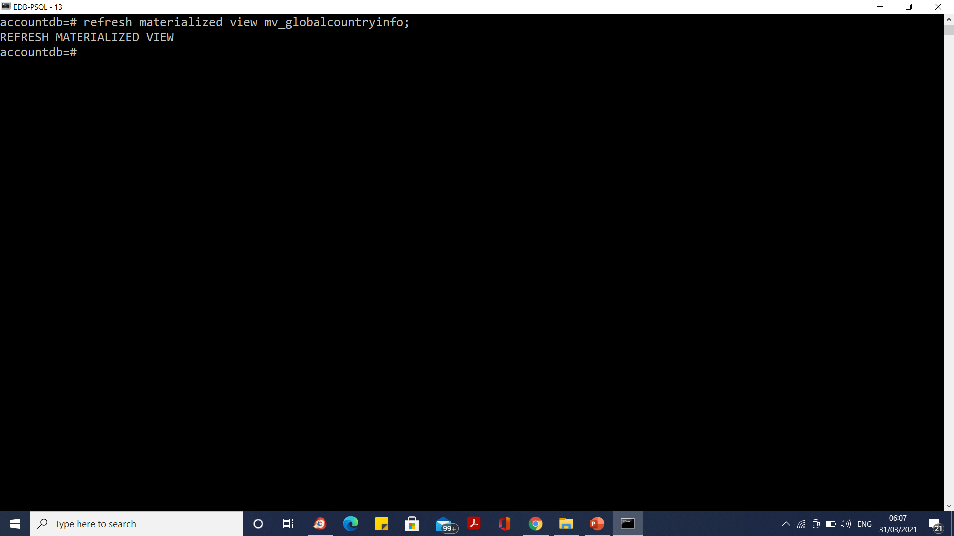
Refreshing a MATERIALIZED VIEW

Slide 155
Postgres Index
An Index is the structure or object by which we can retrieve specific rows or data faster.
Indexes can be created using one or multiple columns or by using the partial data depending on your query requirement conditions.
Index will create a pointer to the actual rows in the specified table.

Slide 156
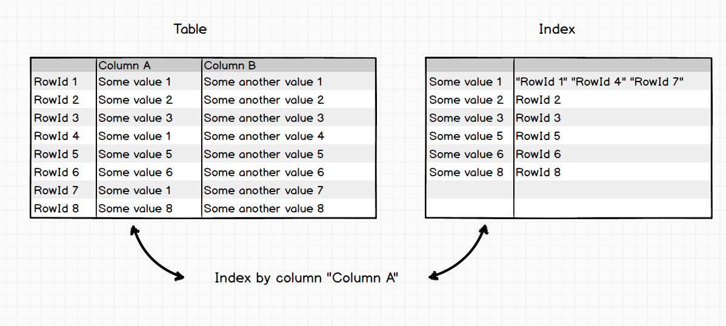
Postgres Index

Slide 157
Postgres Index
Types Of Indexes
PostgreSQL server provides following types of indexes, which each uses a different algorithm:
B-tree
Hash
GiST
SP-GiST
GIN
BRIN

Slide 158
B-tree index
The most common and widely used index type is the B-tree index.
This is the default index type for the CREATE INDEX command, unless you explicitly mention the type during index creation.
If the indexed column is used to perform the comparison by using comparison operators such as <, <=, =, >=, and >, then the Postgres optimizer uses the index created by the B-tree option for the specified column.

Slide 159

B-tree index

Slide 160
B-tree index
Advantages:
Retain sorting data
Support the search for the unary and binary predicates
Allow the entire sequence of data to estimate cardinality (number of entries) for the entire index (and therefore the table), range, and with arbitrary precision without scanning
Disadvantages:
For their construction is require to perform a full sorting pairs (row, RowId) (slow operation)
Take up a lot of disk space. Index on unique “Integers” weights twice more as the column (because additionaly RowId need stored)
Recording unbalances tree constantly, and begins to store data sparsely, and the access time is increased by increasing the amount of disk information. What is why, B-Tree indexes require monitoring and periodic rebuilding

Slide 161
List indexes
SELECT
tablename,
indexname,
indexdef
FROM
pg_indexes
WHERE
schemaname = 'public'
ORDER BY
tablename,
indexname;

Slide 162

List indexes

Slide 163

B-Tree Index

Slide 164

B-Tree Index

Slide 165

B-Tree Index

Slide 166

B-Tree Index

Slide 167

Hash index

Slide 168
Hash index
Advantages:
Very fast search O(1)
Stability - the index does not need to be rebuild
Disadvantages:
Hash is very sensitive to collisions. In the case of “bad” data distribution, most of the entries will be concentrated in a few bouquets, and in fact the search will occur through collision resolution.

Slide 169

Hash index
The Hash index can be used only if the equality condition = is being used in the query.

Slide 170
Bitmap index
Bitmap index create a separate bitmap (a sequence of 0 and 1) for each possible value of the column, where each bit corresponds to a string with an indexed value. Bitmap indexes are optimal for data where bit unique values (example, gender field).

Slide 171

Bitmap index

Slide 172
Bitmap index
Advantages:
Compact representation (small amount of disk space)
Fast reading and searching for the predicate “is”
Effective algorithms for packing masks (even more compact representation, than indexed data)
Disadvantages:
You can not change the method of encoding values in the process of updating the data. From this it follows that if the distribution data has changed, it is required the index to be completely rebuild

Slide 173
GiST index (Generalized Search Tree index)
GiST stands for Generalized Search Tree Index.
The main point of GiST is to be able to index queries that simply are not indexable using B-tree.
So GiST is useful when you have queries that are not btree-indexable.
The column can be of tsvector or tsquery type.
There is a well-known, and pretty fast, geographic extension to PostgreSQL — PostGIS, which uses GiST for its purposes. GiST indexes are what is used if you want to speed up full text searches.

Slide 174

GiST index (Generalized Search Tree index)

Slide 175
GiST index (Generalized Search Tree index)

Slide 176
SP-GiST (Space-Partitioned GiST)
SP-GiST stands for “space-partitioned GiST.”
This index type supports non-balanced data structures such as quadtrees, k-d trees, and radix trees.

Slide 177
GIN (Generalized Inverted Index)
GIN stands for “Generalized Inverted Index.” This are the “Inverted Indexes” that get used for multiple component values such as arrays.
The standard distribution of PostgreSQL includes a GIN operator class for arrays, which supports indexed queries using these operators: <@, @>, =, and &&.

Slide 178
BRIN (Block Range index)
BRIN stands for “Block Range index.” This featured index type was introduced with Postgres v 9.5.
“Because a BRIN index is very small, scanning the index adds little overhead compared to a sequential scan, but may avoid scanning large parts of the table that are known not to contain matching tuples.”
“The size of the block range is determined at index creation time by the pages_per_range storage parameter.
The number of index entries will be equal to the size of the relation in pages divided by the selected value for pages_per_range.
Therefore, the smaller the number, the larger the index becomes (because of the need to store more index entries), but at the same time the summary data stored can be more precise and more data blocks can be skipped during an index scan.”

Slide 179
BRIN (Block Range index)
In a BRIN index, PostgreSQL reads your selected column's maximum and minimum values for each 8k-size page of stored data, and then stores that information (page number and minimum and maximum values of column) into the BRIN index.

Slide 180
BRIN (Block Range index)
B-tree indexes have entries for each row in your table, duplicating the data in the indexed columns.
This permits super-fast index-only scans, but can be wasteful of disk space.
A B-tree index also stores the data in sorted order, which permits very fast lookups of single rows.
It also stores the full location of each row in the table, which can require a lot of work when running queries that return many rows.
However, a BRIN index contains only the minimum and maximum values contained in a group of database pages.
Therefore, the reason for using the BRIN index is that this is a very straightforward way to optimize for speed, and the BRIN index only takes up very little space compared to a B-tree index.
BRIN is designed for handling very large tables in which certain columns have some natural correlation with their physical location within the table.

Slide 181
BRIN (Block Range index)
A good example of where you could use a BRIN index is for data you would consider immutable.
For the example that follows, the BRIN index is 72kb in size, while the B-tree index is 676mb in size.
Yet the performance is pretty much identical for selects.

Slide 182

BRIN (Block Range index)

Slide 183
Partial Index
The partial index is useful in case you have commonly used WHERE conditions which use constant values as follows:
SELECT *
FROM table_name
WHERE column_name = constant_value;

Slide 184
Partial Index
You can optimize this query by creating an index for the active column as follows:
CREATE INDEX idx_customer_active
ON customer(active);
This index fulfills its purpose, however, it includes many rows that are never searched, namely all the active customers.
To define an index that includes only inactive customers, you use the following statement:
CREATE INDEX idx_customer_inactive
ON customer(active)
WHERE active = 0;

Slide 185
Moving Data the Copy command
import and export data using CSV files in PostgreSQL
1. Creating a .csv file
2. Creating the table structure
3. Importing from a psql prompt
4. Importing from a shell prompt
5. Exporting data to a .csv file

Slide 186
Moving Data the Copy command
Creating a .csv file
The first step is to create a .csv file. You can use any existing file, or you can use the data below that comprises a basic .csv file:
Capital_City,State,Abbreviation,Zip_Code
Montgomery,Alabama,AL,36104
Juneau,Alaska,AK,99801
Phoenix,Arizona,AZ,85001
Little Rock,Arkansas,AR,72201

Slide 187
Moving Data the Copy command
CREATE TABLE usa
(Capital_city varchar,
State varchar,
Abbreviation varchar(2),
zip_code numeric(5)
);

Slide 188
Importing from a psql prompt
\COPY <table name> FROM 'location + file_name' DELIMITER ',' CSV HEADER;
To understand the execution steps, let’s look at each item in this command:
\COPY: This is the command to copy the record to / from the .csv file.
<table name>: Provides the table name where you want to import the data.
FROM: Specifies that we are going to import from a file (we will also be using TO in order to export it to a file at a later stage).

Slide 189
Importing from a psql prompt
'location + file_name': An absolute path to the file (make sure you have read access to the file).
DELIMITER ',': Specifies the delimiter, which in our case is a comma: ‘,’.
CSV Specifies the file type from which we are going to import.
HEADER Signifies that we have a header row in our .csv file and while importing we should ignore the first row (similarly, while exporting we can use this to specify whether we want to include or exclude the header file).

Slide 190

Importing from a psql prompt

Slide 191

Exporting data to a .csv file

Slide 192
Understanding And Reading the PostgreSQL System Catalog (Meta Data)
The PostgreSQL System Catalog is a schema with tables and views that contain metadata about all the other objects inside the database and more.
With it, we can discover when various operations happen, how tables or indexes are accessed, and even whether or not the database system is reading information from memory or needing to fetch data from disk.

Slide 193
Understanding And Reading the PostgreSQL System Catalog (Meta Data)
PostgreSQL stores the metadata information about the database and cluster in the schema ‘pg_catalog’.
This information is partially used by PostgreSQL itself to keep track of things itself, but it also is presented so external people / processes can understand the inside of the databases too.

Slide 194
Understanding And Reading the PostgreSQL System Catalog (Meta Data)
Database Information
General database info is stored in pg_database and statistics are stored in pg_stat_database.
SELECT oid,* FROM pg_database WHERE datname = 'accountdb’;
SELECT * FROM pg_stat_database WHERE datname = ‘accountdb';

Slide 195
Understanding And Reading the PostgreSQL System Catalog (Meta Data)
Database Activity and Locks
There are two views that show current user activity, pg_stat_activity and pg_locks.
When queried, these show information about current connections to the databases, and what kind of locks they have on what relations.
SELECT * FROM pg_stat_activity;
SELECT * FROM pg_locks;

Slide 196
Understanding And Reading the PostgreSQL System Catalog (Meta Data)
SELECT * FROM pg_stat_user_tables WHERE schemaname = 'public' AND relname = 'history’;

Slide 197
Understanding And Reading the PostgreSQL System Catalog (Meta Data)
Table Vacuum Activity
Table maintenance is done through either VACUUM or AUTOVACUUM, and statistics are gathered through ANALYZE or AUTOANALYZE.
The next four columns contain the dates for when each of these operations were last run: ‘last_vacuum’, ‘last_autovacuum’, ‘last_analyze’, ‘last_autoanalyze’.
We also have four more convenient columns that simply count how many times the previous actions occur.
Using these, we can see which tables get the most activity: ‘vacuum_count’, ‘autovacuum_count’, ‘analyze_count’, and ‘autoanalyze_count’.

Slide 198
Understanding And Reading the PostgreSQL System Catalog (Meta Data)
SELECT * FROM pg_statio_user_tables WHERE schemaname = 'public' AND relname = history;
Index Meta data
SELECT * FROM pg_stat_user_indexes WHERE indexrelname = 'history_pkey’;

Slide 199
How to use table partitioning to scale PostgreSQL
1. Benefits of partitioning
2. When to use partitioning
3. How to use partitioning
a. List partition
b. Range partition
c. Hash partition
d. Multilevel partition
4. Limitations

Slide 200
Partitioning
With huge data being stored in databases, performance and scaling are two main factors that are affected.
As table size increases with data load, more data scanning, swapping pages to memory, and other table operation costs also increase.
Partitioning may be a good solution, as It can help divide a large table into smaller tables and thus reduce table scans and memory swap problems, which ultimately increases performance.
Partitioning helps to scale PostgreSQL by splitting large logical tables into smaller physical tables that can be stored on different storage media based on uses.
Users can take better advantage of scaling by using declarative partitioning along with foreign tables using postgres_fdw.

Slide 201
Benefits of Partitioning
PostgreSQL declarative partitioning is highly flexible and provides good control to users.
Users can create any level of partitioning based on need and can modify, use constraints, triggers, and indexes on each partition separately as well as on all partitions together.
Query performance can be increased significantly compared to selecting from a single large table.
Partition-wise-join and partition-wise-aggregate features increase complex query computation performance as well.
Bulk loads and data deletion can be much faster, as based on user requirements these operations can be performed on individual partitions.
Each partition can contain data based on its frequency of use and so can be stored on media that may be cheaper or slower for low-use data.

Slide 202
When to use partitioning
Most benefits of partitioning can be enjoyed when a single table is not able to provide them.
So we can say that if a lot of data is going to be written on a single table at some point, users need partitioning.
Apart from data, there may be other factors users should consider, like update frequency of the data, use of data over a time period, how small a range data can be divided, etc.
With good planning and taking all factors into consideration, table partitioning can give a great performance boost and scale your PostgreSQL to larger datasets.

Slide 203
How to use partitioning
As of PostgreSQL12 release List, Range, Hash and combinations of these partition methods at different levels are supported.

Slide 204
LIST PARTITION
A list partition is created with predefined values to hold in a partitioned table.
A default partition (optional) holds all those values that are not part of any specified partition.
CREATE TABLE customers (id INTEGER, status TEXT, arr NUMERIC) PARTITION BY LIST(status);
CREATE TABLE cust_active PARTITION OF customers FOR VALUES IN ('ACTIVE’);
CREATE TABLE cust_archived PARTITION OF customers FOR VALUES IN ('EXPIRED’);
CREATE TABLE cust_others PARTITION OF customers DEFAULT;

Slide 205
RANGE PARTITION
A range partition is created to hold values within a range provided on the partition key.
Both minimum and maximum values of the range need to be specified, where minimum value is inclusive and maximum value is exclusive.
CREATE TABLE customers (id INTEGER, status TEXT, arr NUMERIC) PARTITION BY RANGE(arr);
CREATE TABLE cust_arr_small PARTITION OF customers FOR VALUES FROM (MINVALUE) TO (25);

Slide 206
RANGE PARTITION
CREATE TABLE cust_arr_medium PARTITION OF customers FOR VALUES FROM (25) TO (75);
CREATE TABLE cust_arr_large PARTITION OF customers FOR VALUES FROM (75) TO (MAXVALUE);

Slide 207
HASH PARTITION
A hash partition is created by using modulus and remainder for each partition, where rows are inserted by generating a hash value using these modulus and remainders.
CREATE TABLE customers (id INTEGER, status TEXT, arr NUMERIC) PARTITION BY HASH(id);
CREATE TABLE cust_part1 PARTITION OF customers FOR VALUES WITH (modulus 3, remainder 0);

Slide 208
HASH PARTITION
CREATE TABLE cust_part2 PARTITION OF customers FOR VALUES WITH (modulus 3, remainder 1);
CREATE TABLE cust_part3 PARTITION OF customers FOR VALUES WITH (modulus 3, remainder 2);

Slide 209
MULTILEVEL PARTITION
PostgreSQL multilevel partitions can be created up to N levels.
Partition methods LIST-LIST, LIST-RANGE, LIST-HASH, RANGE-RANGE, RANGE-LIST, RANGE-HASH, HASH-HASH, HASH-LIST, and HASH-RANGE can be created in PostgreSQL declarative partitioning.

Slide 210
MULTILEVEL PARTITION
CREATE TABLE customers (id INTEGER, status TEXT, arr NUMERIC) PARTITION BY LIST(status);
CREATE TABLE cust_active PARTITION OF customers FOR VALUES IN ('ACTIVE','RECURRING','REACTIVATED') PARTITION BY RANGE(arr);
CREATE TABLE cust_arr_small PARTITION OF cust_active FOR VALUES FROM (MINVALUE) TO (101) PARTITION BY HASH(id);

Slide 211
MULTILEVEL PARTITION
CREATE TABLE cust_arr_small PARTITION OF cust_active FOR VALUES FROM (MINVALUE) TO (101) PARTITION BY HASH(id);
CREATE TABLE cust_part11 PARTITION OF cust_arr_small FOR VALUES WITH (modulus 2, remainder 0);
CREATE TABLE cust_part12 PARTITION OF cust_arr_small FOR VALUES WITH (modulus 2, remainder 1);
CREATE TABLE cust_other PARTITION OF customers DEFAULT PARTITION BY RANGE(arr);

Slide 212
MULTILEVEL PARTITION
CREATE TABLE cust_arr_large PARTITION OF cust_other FOR VALUES FROM (101) TO (MAXVALUE) PARTITION BY HASH(id);
CREATE TABLE cust_part21 PARTITION OF cust_arr_large FOR VALUES WITH (modulus 2, remainder 0);
postgres=# CREATE TABLE cust_part22 PARTITION OF cust_arr_large FOR VALUES WITH (modulus 2, remainder 1);

Slide 213
Limitations
Partitioning was introduced in PostgreSQL 10 and continues to be improved and made more stable. Still, there are certain limitations that users may need to consider:
1. Unique constraints on partitioned tables must include all the partition key columns. One work-around is to create unique constraints on each partition instead of a partitioned table.
2. Partition does not support BEFORE ROW triggers on partitioned tables. If necessary, they must be defined on individual partitions, not the partitioned table.
3. Range partition does not allow NULL values.
4. PostgreSQL does not create a system-defined subpartition when not given it explicitly, so if a subpartition is present at least one partition should be present to hold values.
5. In the case of HASH-LIST, HASH-RANGE, and HASH-HASH composite partitions, users need to make sure all partitions are present at the subpartition level as HASH can direct values at any partition based on hash value.

Slide 214

Postgres vs Oracle

Slide 215

Postgres vs Oracle

Slide 216

Postgres vs Oracle

Slide 217

Postgres vs Oracle

Slide 218

Postgres vs Oracle

Slide 219

Postgres vs Oracle

Slide 220

Postgres vs Oracle

Slide 221
Backup and Restore
PostgreSQL provides the pg_dump utility to help you back up databases.
It generates a database file with SQL commands in a format that can be easily restored in the future.
To back up, a PostgreSQL database, start by logging into your database server, then switch to the Postgres user account, and run pg_dump as follows (replace tecmintdb with the name of the database you want to backup).
By default, the output format is a plain-text SQL script file.

Slide 222
Backup and Restore
Understand the Basic Syntax of pg_dump
PostgreSQL comes with built-in utilities called pg_dump for easily creating and restoring backups.
The basic syntax of pg_dump command is shown below:
pg_dump [OPTION]... [DBNAME]
A brief explanation of each option is shown below:
-d, –dbname=DATABASENAME : Used to specify the database that you want to back up.
-h, –host=HOSTNAME : Used to specify the hostname of your database server.
-U, –username=USERNAME : Used to specify the PostgreSQL username.
-w, –no-password : Used to ignore the password prompt.
-p, –port=PORT : Used to specify the PostgreSQL server port number.
-W, –password : Used to force password prompt.
–role=ROLENAME : SET ROLE before the dump.

Slide 223
Backup and Restore
Backup
pg_dump -d testdb -f testdb_backup.sql
Restore
psql -d testdb -f testdb_backup.sql
If you want to stop the database restore process in case an error occurs, run the following command:
psql -d testdb --set ON_ERROR_STOP=on -f testdb_backup.sql

Slide 224


Backup and Restore

Slide 225
Backup and Restore All Databases
You can back up all databases in PostgreSQL using pg_dumpall utility. The basic syntax to backup all databases as shown below:
pg_dumpall -f [alldatabase_backup.sql]
For example, to back up all databases in PostgreSQL and generate a backup file named alldb_backup.sql, run the following command:
pg_dumpall -f alldb_backup.sql
To restore all databases from a backup file named alldb_backup.sql, run the following command:
psql -f alldb_backup.sql

Slide 226
Backup and Restore Single Table
PostgreSQL also allows you to back up a single table from the specific database. You can achieve this using the following syntax:
pg_dump -d [source-database] -t [table_name]-f [dbtable_backup.sql]
For example, to back up a table named mytab from the database named testdb and generate a backup file named testdb_mytab.sql, run the following command:
pg_dump -d testdb -t mytab -f testdb_mytab_backup.sql
If you want to restore this table from the backup file, run the following command:
psql -d testdb -f testdb_mytab_backup.sql

Slide 227
Backup and Restore Compressed Data Store
You can also back up the PostgreSQL database and compress it in .gz format to reduce the backup size.
To take a back up of database named testdb and generate a compressed backup file named testdb_compressed.sql.gz, run the following command:
pg_dump -d testdb | gzip > testdb_compressed.sql.gz
You can also restore the backup from the compressed file using the following command:
gunzip -c testdb_compressed.sql.gz | psql -d testdb

Slide 228
PL/PGSQL
PL/pgSQL procedural language adds many procedural elements e.g., control structures, loops, and complex computations to extend standard SQL.
It allows you to develop complex functions and stored procedures in PostgreSQL that may not be possible using plain SQL.
Since PostgreSQL 9.0, PL/pgSQL is installed by default.

Slide 229
PL/PGSQL
PL/pgSQL procedural language is similar to the Oracle PL/SQL. The following are reasons to learn PL/pgSQL:
PL/pgSQL is easy to learn and simple to use.
PL/pgSQL comes with PostgreSQL by default. The user-defined functions and stored procedures developed in PL/pgSQL can be used like any built-in functions and stored procedures.
PL/pgSQL inherits all user-defined types, functions, and operators.
PL/pgSQL has many features that allow you to develop complex functions and stored procedures.
PL/pgSQL can be defined to be trusted by the PostgreSQL database server.

Slide 230
PL/PGSQL
PL/pgSQL is a procedural programming language for the PostgreSQL database system.
PL/pgSQL allows you to extend the functionality of the PostgreSQL database server by creating server objects with complex logic.
PL/pgSQL was designed to :
Create user-defined functions, stored procedures, and triggers.
Extend standard SQL by adding control structures such as if, case, and loop statements.
Inherit all user-defined functions, operators, and types.

Slide 231
Advantages of using PL/pgSQL
SQL is a query language that allows you to query data from the database easily. However, PostgreSQL only can execute SQL statements individually.
It means that you have multiple statements, you need to execute them one by one like this:
First, send a query to the PostgreSQL database server.
Next, wait for it to process.
Then, process the result set.
After that, do some calculations.
Finally, send another query to the PostgreSQL database server and repeat this process.

Slide 232
Advantages of using PL/pgSQL
This process incurs the interprocess communication and network overheads.
To resolve this issue, PostgreSQL uses PL/pgSQL.
PL/pgSQL wraps multiple statements in an object and store it on the PostgreSQL database server.
So instead of sending multiple statements to the server one by one, you can send one statement to execute the object stored in the server. This allows you to:
Reduce the number of round trips between the application and the PostgreSQL database server.
Avoid transferring the immediate results between the application and the server.

Slide 233
PostgreSQL PL/pgSQL disadvantages
Besides the advantages of using PL/pgSQL, there are some caveats:
Slower in software development because PL/pgSQL requires specialized skills that many developers do not possess.
Difficult to manage versions and hard to debug.
May not be portable to other database management systems.

Slide 234
Dollar-Quoted String Constants
In PostgreSQL, you use single quotes for a string constant like this:
select 'String constant’;
When a string constant contains a single quote ('), you need to escape it by doubling up the single quote. For example:
select 'I''m also a string constant’;

Slide 235
Dollar-Quoted String Constants
PostgreSQL version 8.0 introduced the dollar quoting feature to make string constants more readable.
The following shows the syntax of the dollar-quoted string constants:
$tag$<string_constant>$tag$
In this syntax, the tag is optional. It may contain zero or many characters.
Between the $tag$, you can place any string with single quotes (') and backslashes (\).
For example:
select $$I'm a string constant that contains a backslash \$$;

Slide 236
Dollar-Quoted String Constants
In this example, we did not specify the tag between the two dollar signs($).
The following example uses the dollar-quoted string constant syntax with a tag:
SELECT $message$I'm a string constant that contains a backslash \$message$;
In this example, we used the string message as a tag between the two dollar signs ($ )

Slide 237
Using dollar-quoted string constant in anonymous blocks
do
'declare
film_count integer;
begin
select count(*) into film_count
from film;
raise notice ''The number of films: %'', film_count;
end;';

Slide 238
Using dollar-quoted string constant in anonymous blocks
To avoid escaping every single quotes and backslashes, you can use the dollar-quoted string as follows
do
$$
declare
film_count integer;
begin
select count(*) into film_count
from film;
raise notice 'The number of films: %', film_count;
end;
$$

Slide 239

Using dollar-quoted string constant in anonymous blocks

Slide 240
Using dollar-quoted string constants in functions
create function find_film_by_id(
id int
) returns film
language sql
as
$$
select * from film
where film_id = id;
$$;

Slide 241


Using dollar-quoted string constants in functions

Slide 242
PL/pgSQL Block Structure
PL/pgSQL is a block-structured language, therefore, a PL/pgSQL function or stored procedure is organized into blocks.
[ <<label>> ]
[ declare
declarations ]
begin
statements;
...
end [ label ];

Slide 243
PL/pgSQL Block Structure
PL/pgSQL is a block-structured language, therefore, a PL/pgSQL function or stored procedure is organized into blocks.
[ <<label>> ]
[ declare
declarations ]
begin
statements;
...
end [ label ];

Slide 244
PL/pgSQL Block Structure
Each block has two sections: declaration and body.
The declaration section is optional while the body section is required.
A block is ended with a semicolon (;) after the END keyword.
A block may have an optional label located at the beginning and at the end.
We use the block label when you want to specify it in the EXIT statement of the block body or when you want to qualify the names of variables declared in the block.
The declaration section is where you declare all variables used within the body section.
Each statement in the declaration section is terminated with a semicolon (;).
The body section is where you place the code. Each statement in the body section is also terminated with a semicolon (;).

Slide 245
PL/pgSQL Block Structure
do $$
<<first_block>>
declare
film_count integer := 0;
begin
-- get the number of films
select count(*)
into film_count
from films;
-- display a message
raise notice 'The number of films is %', film_count;
end first_block $$;

Slide 246

PL/pgSQL Block Structure

Slide 247

PL/pgSQL Subblocks
PL/pgSQL allows you to place a block inside the body of another block.
The block nested inside another block is called a subblock. The block that contains the subblock is referred to as an outer block.

Slide 248
Introduction to variables in PL/pgSQL
A variable is a meaningful name of a memory location.
A variable holds a value that can be changed through the block.
A variable is always associated with a particular data type.
variable_name data_type [:= expression];

Slide 249
Introduction to variables in PL/pgSQL
First, specify the name of the variable.
It is a good practice to assign a meaningful name to a variable.
For example, instead of naming a variable i you should use index or counter.
Second, associate a specific data type with the variable.
The data type can be any valid data type such as integer, numeric, varchar, and char.
Third, optionally assign a default value to a variable. If you don’t do so, the initial value of the variable is NULL.

Slide 250
Introduction to variables in PL/pgSQL
First, specify the name of the variable.
It is a good practice to assign a meaningful name to a variable.
For example, instead of naming a variable i you should use index or counter.
Second, associate a specific data type with the variable.
The data type can be any valid data type such as integer, numeric, varchar, and char.
Third, optionally assign a default value to a variable. If you don’t do so, the initial value of the variable is NULL.
Note that you can use either := or = assignment operator to initialize and assign a value to a variable.

Slide 251
Introduction to variables in PL/pgSQL
do $$
declare
counter integer := 1;
first_name varchar(50) := 'John';
last_name varchar(50) := 'Doe';
payment numeric(11,2) := 20.5;
begin
raise notice '% % % has been paid % USD',
counter,
first_name,
last_name,
payment;
end $$;

Slide 252
Variable initialization timing
do $$
declare
created_at time := now();
begin
raise notice '%', created_at;
perform pg_sleep(10);
raise notice '%', created_at;
end $$;

Slide 253

Variable initialization timing

Slide 254
Copying data types
The %type provides the data type of a table column or another variable.
Typically, you use the %type to declare a variable that holds a value from the database or another variable.
variable_name table_name.column_name%type;
And the following shows how to declare a variable with the data type of another variable:
variable_name variable%type;

Slide 255
Copying data types
do $$
declare
film_title films.title%type;
featured_title film_title%type;
begin
-- get title of the film id 100
select title
from films
into film_title
where film_id = 1;
-- show the film title
raise notice 'Film title id 100: %s', film_title;
end; $$

Slide 256
Variables in block and subblock
When you declare a variable in a subblock which has the same name as another variable in the outer block, the variable in the outer block is hidden in the subblock.

Slide 257
do $$
<<outer_block>>
declare
counter integer := 0;
begin
counter := counter + 1;
raise notice 'The current value of the counter is %', counter;
declare
counter integer := 0;
begin
counter := counter + 10;
raise notice 'Counter in the subblock is %', counter;
raise notice 'Counter in the outer block is %', outer_block.counter;
end;
raise notice 'Counter in the outer block is %', counter;
end outer_block $$;

Slide 258
PL/pgSQL row types example
do $$
declare
selected_film films%rowtype;
begin
-- select film with id 1
select *
from films
into selected_film
where film_id = 1;
-- show the number of actor
raise notice 'The film name is % %',
selected_film.film_id,
selected_film.title;
end; $$

Slide 259
PL/pgSQL Record Types
do
$$
declare
rec record;
begin
-- select the film
select film_id, title
into rec
from films
where film_id = 1;
raise notice '% %', rec.film_id, rec.title;
end;
$$

Slide 260
Using record variables in the for loop statement
do
$$
declare
rec record;
begin
for rec in select title
from films
where film_id > 0
order by title
loop
raise notice '%', rec.title;
end loop;
end;
$$

Slide 261
PL/pgSQL Constants
do $$
declare
vat constant numeric := 0.1;
net_price numeric := 20.5;
begin
raise notice 'The selling price is %', net_price * ( 1 + vat );
end $$;

Slide 262
PL/pgSQL Errors and Messages
Reporting messages
To raise a message, you use the raise statement as follows:
raise level format;
Following the raise statement is the level option that specifies the error severity.
PostgreSQL provides the following levels:
debug
log
notice
info
warning
exception

Slide 263
Reporting Messages
do $$
begin
raise info 'information message %', now() ;
raise log 'log message %', now();
raise debug 'debug message %', now();
raise warning 'warning message %', now();
raise notice 'notice message %', now();
end $$;

Slide 264
Raising errors
To raise an error, you use the exception level after the raise statement.
Note that raise statement uses the exception level by default.

Slide 265
Raising errors
Besides raising an error, you can add more information by using the following additional clause:
using option = expression
The option can be:
message: set error message
hint: provide the hint message so that the root cause of the error is easier to be discovered.
detail: give detailed information about the error.
errcode: identify the error code, which can be either by condition name or directly five-character SQLSTATE code. Please refer to the table of error codes and condition names.

Slide 266
Raising Errors
do $$
declare
email varchar(255) := 'info@postgresqltutorial.com';
begin
-- check email for duplicate
-- ...
-- report duplicate email
raise exception 'duplicate email: %', email
using hint = 'check the email again';
end $$;

Slide 267
Assert Statement
do $$
declare
film_count integer;
begin
select count(*)
into film_count
from films;
assert film_count > 1000, '1000 Film not found, check the film table';
end$$;

Slide 268
PL/pgSQL IF Statement
The if statement determines which statements to execute based on the result of a boolean expression.
PL/pgSQL provides you with three forms of the if statements.
if then
if then else
if then elsif

Slide 269
PL/pgSQL IF Statement
PL/pgSQL if-then statement
The following illustrates the simplest form of the if statement:
if condition then
statements;
end if;

Slide 270
PL/pgSQL IF Statement
do $$
declare
selected_film films%rowtype;
input_film_id films.film_id%type := 0;
begin
select * from films
into selected_film
where film_id = input_film_id;
if not found then
raise notice'The film % could not be found',
input_film_id;
end if;
end $$

Slide 271
PL/pgSQL if-then-else statement
if condition then
statements;
else
alternative-statements;
END if;

Slide 272
PL/pgSQL if-then-else statement
if condition then
statements;
else
alternative-statements;
END if;

Slide 273
PL/pgSQL if-then-else statement
do $$
declare
selected_film films%rowtype;
input_film_id films.film_id%type := 100;
begin
select * from films
into selected_film
where film_id = input_film_id;
if not found then
raise notice 'The film % could not be found',
input_film_id;
else
raise notice 'The film title is %', selected_film.title;
end if;
end $$

Slide 274
PL/pgSQL if-then-elsif Statement
if condition_1 then
statement_1;
elsif condition_2 then
statement_2
...
elsif condition_n then
statement_n;
else
else-statement;
end if;

Slide 275
PL/pgSQL if-then-elsif Statement
do $$
declare
v_film films%rowtype;
len_description varchar(100);
begin
select * from films
into v_film
where film_id = 100;
if not found then
raise notice 'Film not found';
else

Slide 276
PL/pgSQL if-then-elsif Statement
if v_film.length >0 and v_film.length <= 50 then
len_description := 'Short';
elsif v_film.length > 50 and v_film.length < 120 then
len_description := 'Medium';
elsif v_film.length > 120 then
len_description := 'Long';
else
len_description := 'N/A';
end if;
raise notice 'The % film is %.',
v_film.title,
len_description;
end if;
end $$

Slide 277
PL/pgSQL CASE Statement
The case statement selects a when section to execute from a list of when sections based on a condition.
The case statement has two forms:
Simple case statement
Searched case statement

Slide 278
Simple case statement
case search-expression
when expression_1 [, expression_2, ...] then
when-statements
[ ... ]
[else
else-statements ]
END case;

Slide 279
Searched case statement
case
when boolean-expression-1 then
statements
[ when boolean-expression-2 then
statements
... ]
[ else
statements ]
end case;

Slide 280
While Loop
do $$
declare
counter integer := 0;
begin
while counter < 5 loop
raise notice 'Counter %', counter;
counter := counter + 1;
end loop;
end$$;

Slide 281
For Loop
[ <<label>> ]
for loop_counter in [ reverse ] from.. to [ by step ] loop
statements
end loop [ label ];

Slide 282
For Loop
do
$$
declare
f record;
begin
for f in select title
from films
order by title
limit 10
loop
raise notice ‘%', f.title;
end loop;
end;
$$

Slide 283
Introduction to PostgreSQL CREATE PROCEDURE statement
create [or replace] procedure procedure_name(parameter_list)
language plpgsql
as $$
declare
-- variable declaration
begin
-- stored procedure body
end; $$

Slide 284
Introduction to PostgreSQL CREATE PROCEDURE statement
First, specify the name of the stored procedure after the create procedure keywords.
Second, define parameters for the stored procedure. A stored procedure can accept zero or more parameters.
Third, specify plpgsql as the procedural language for the stored procedure. Note that you can use other procedural languages for the stored procedure such as SQL, C, etc.
Finally, use the dollar-quoted string constant syntax to define the body of the stored procedure.

Slide 285
Create Function
create [or replace] function function_name(param_list)
returns return_type
language plpgsql
as
$$
declare
-- variable declaration
begin
-- logic
end;
$$

Slide 286
PL/pgSQL Function Parameter Modes: IN, OUT, INOUT
IN | OUT | INOUT
The default | Explicitly specified | Explicitly specified
Pass a value to function | Return a value from a function | Pass a value to a function and return an updated value.
in parameters act like constants | out parameters act like uninitialized variables | inout parameters act like an initialized variables
Cannot be assigned a value | Must assign a value | Should be assigned a value

Slide 287
Introduction to PL/pgSQL Function Overloading
PostgreSQL allows multiple functions to share the same name as long as they have different arguments.
If two or more functions share the same name, the function names are overloaded.
When you can call an overloading function, PostgreSQL select the best candidate function to execute based on the the function argument list.

Slide 288
How to Develop a PL/pgSQL Function That Returns a Table
create or replace function function_name (
parameter_list
)
returns table ( column_list )
language plpgsql
as $$
declare
-- variable declaration
begin
-- body
end; $$

Slide 289
Triggers
A PostgreSQL trigger is a function invoked automatically whenever an event such as insert, update, or delete occurs.

Slide 290
Triggers
A PostgreSQL trigger is a function invoked automatically whenever an event associated with a table occurs.
An event could be any of the following: INSERT, UPDATE, DELETE or TRUNCATE.
A trigger is a special user-defined function associated with a table.
To create a new trigger, you define a trigger function first, and then bind this trigger function to a table.
The difference between a trigger and a user-defined function is that a trigger is automatically invoked when a triggering event occurs.
PostgreSQL provides two main types of triggers: row and statement-level triggers. The differences between the two kinds are how many times the trigger is invoked and at what time.

Slide 291
Triggers
For example, if you issue an UPDATE statement that affects 20 rows, the row-level trigger will be invoked 20 times, while the statement level trigger will be invoked 1 time.
You can specify whether the trigger is invoked before or after an event.
If the trigger is invoked before an event, it can skip the operation for the current row or even change the row being updated or inserted.
In case the trigger is invoked after the event, all changes are available to the trigger.

Slide 292
Triggers
Triggers are useful in case the database is accessed by various applications, and you want to keep the cross-functionality within the database that runs automatically whenever the data of the table is modified.
For example, if you want to keep the history of data without requiring the application to have logic to check for every event such as INSERT or UDPATE.

Slide 293
Triggers
You can also use triggers to maintain complex data integrity rules which you cannot implement elsewhere except at the database level.
For example, when a new row is added into the customer table, other rows must be also created in tables of banks and credits.

Slide 294
Triggers
The main drawback of using a trigger is that you must know the trigger exists and understand its logic to figure it out the effects when data changes.
Even though PostgreSQL implements SQL standard, triggers in PostgreSQL has some specific features:
PostgreSQL fires trigger for the TRUNCATE event.
PostgreSQL allows you to define the statement-level trigger on views.
PostgreSQL requires you to define a user-defined function as the action of the trigger, while the SQL standard allows you to use any SQL commands.

Slide 295
PostgreSQL CREATE TRIGGER
To create a new trigger in PostgreSQL, you follow these steps:
First, create a trigger function using CREATE FUNCTION statement.
Second, bind the trigger function to a table by using CREATE TRIGGER statement.

Slide 296
PostgreSQL CREATE TRIGGER
CREATE FUNCTION trigger_function()
RETURNS TRIGGER
LANGUAGE PLPGSQL
AS $$
BEGIN
-- trigger logic
END;
$$

Slide 297
Inheritance
CREATE TABLE CUSTOMERS (
name text,
age int,
address text
);
CREATE TABLE OFFICE_CUSTOMERS(
office_address text
) INHERITS (customers)

Slide 298
Inheritance
INSERT INTO CUSTOMERS VALUES('ravi','32','32, head street');
INSERT INTO CUSTOMERS VALUES('michael','35','56, gotham street');
INSERT INTO OFFICE_CUSTOMERS VALUES('bane','28','56, circadia street','92 homebush');

Slide 299
Non Atomic Columns
CREATE TABLE customer (
name text,
Address text,
payment_schedule integer[],
);

Slide 300
Non Atomic Columns
INSERT INTO CUSTOMER_SCHEDULE VALUES( 'jack',
'Athens, Colarado',
'{1,2,3,4}'
)
INSERT INTO CUSTOMER_SCHEDULE VALUES( 'jackson',
'Tennessey, greece',
'{1,7,3,4}'
)

Slide 301
Non Atomic Columns
SELECT * FROM CUSTOMER_SCHEDULE WHERE
CUSTOMER_SCHEDULE.payment_schedule[1] <> CUSTOMER_SCHEDULE.payment_schedule[2];

Slide 302
Postgres Cluster
.\initdb.exe -D e:/PostgreSQL/14/data
Change the server port in data folder config file
.\pg_ctl.exe start -D e:\PostgreSQL\14\data
Server started
psql -h localhost -d postgres -p 5436 -W

Slide 303
Postgres Replication
#5432
CREATE TABLE LogicalReplicationTest (id int PRIMARY KEY);
INSERT INTO LogicalReplicationTest VALUES (generate_series(1,10000));
SELECT count(*) FROM LogicalReplicationTest;
CREATE PUBLICATION testpub FOR TABLE LogicalReplicationTest;
#5436
CREATE TABLE LogicalReplicationTest (id int PRIMARY KEY);
CREATE SUBSCRIPTION testsub CONNECTION 'host=localhost port=5432 user=postgres password=vignesh dbname=testdb' PUBLICATION testpub;

Slide 304
Questions

Slide 305
Module Summary
In this module we discussed
Installing Postgres
Querying Postgres
Data Management
PL/SQL

